Slide 1
Egyptian Artistic Conventions
CHW3M

Slide 2
Every society has a certain ideal standard of beauty
What’s ours?
Is it universal?

Slide 3
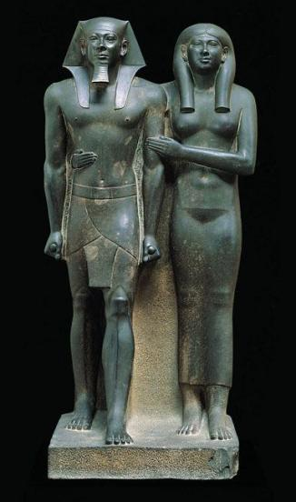
Continuity in Egyptian Art
Statue of King Mankaure and His Queen
Conservatism – some innovations but mostly the same unwritten rules (conventions)
Religious purpose (not realism)
Pharaoh as chief subject and patron
StudyBlue. “Introduction to the Arts.” Last modified 2013. http://www.studyblue.com/notes/note/n/introduction-to-the-arts-midterm/deck/2416850

Slide 4
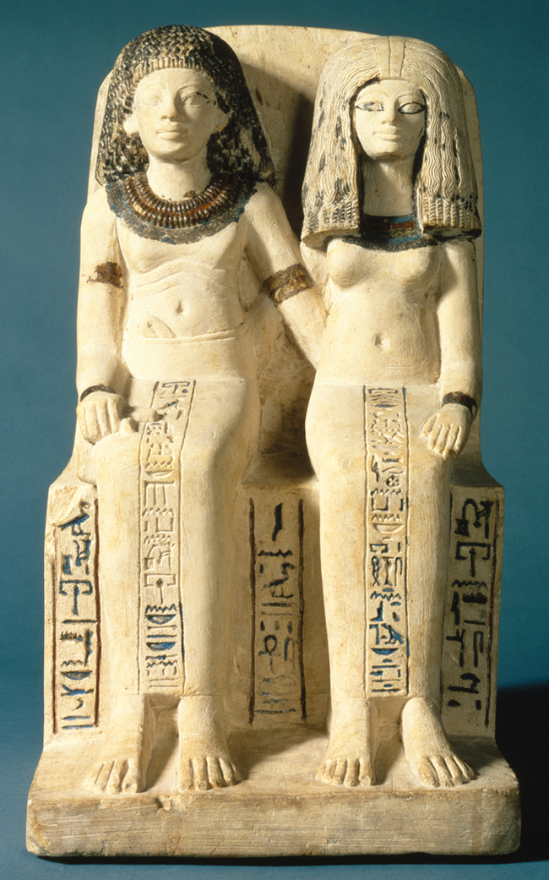
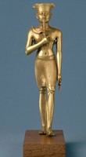
Statues
Look straight ahead
No activity (rigid)
Show no emotion (for majesty)
A Scribe and his Wife
Gold Statue of Amun
Brooklyn Museum. Last modified 2003. http://www.brooklynmuseum.org/exhibitions/egypt_reborn/#

Slide 5
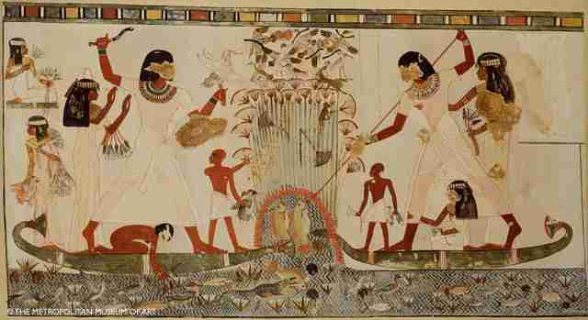
Relief and Painting
Show character of the deceased to the gods, what they hope to do in the afterlife
Precision over perspective (viewer can see the contents and ladle in a pot or a bowl)
Tomb Painting from the Tomb of a Man Named Menna
Unknown. “Egyptian Afterlife.” Last modified 2009. http://www.crystalinks.com/egyptafterlife.html

Slide 6
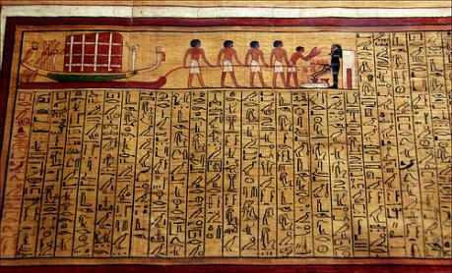
Scene from Book of the Dead
Lenka Peacock, Turin Museum: The tomb of Kha, 2015, http://www.deirelmedina.com/lenka/TurinKha.html (Sept. 29, 2015)
Colour
-Men (red) - depicts their outdoor life
-Women (yellow) - shows they are indoors and protected

Slide 7
Scale:
-Size shows status
-Central figure much larger
-Men larger than wives
-Wives and kids often crouch below hugging calves
Statue of Nykara and His Family
Brooklyn Museum. Last Date Modified 2003. http://www.brooklynmuseum.org/exhibitions/egypt_reborn/#

Slide 8
Statue of Ramses II at Karnak Temple
- Notice the female figure
Wikimedia Commons, Statue of Ramses II at Karnak, 2016, https://commons.wikimedia.org/wiki/File:Statue_of_Ramesses_II_in_Karnak_Temple_in_Luxor_Egypt.JPG

