Slide 1
Studying for Exams
Ms. Gluskin, Student Success Teacher, York Mills CI
risa.gluskin@tdsb.on.ca
gluskin.ca
January 2020

Slide 2
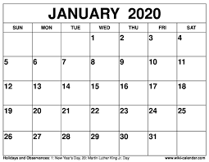
January Exam Schedule
START
END
Sem 2 starts

Slide 3
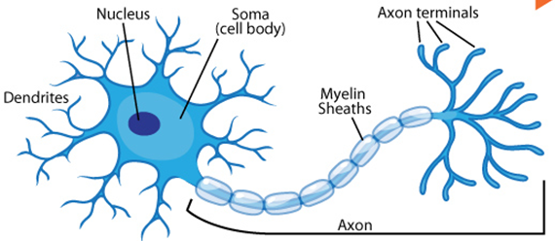
How We Learn = How We Study
Connections between neurons are formed when we learn.
We reinforce the connections through PRACTICE.
It’s the same for studying – we must practice what we have learned.

Slide 4
No Multi-Tasking
You cannot learn when you’re checking your phone.
It takes your attention and focus away from the task.
You are wasting your time if you check your phone while you study.

Slide 5
BAD METHODS OF STUDY
Copying out all of your notes.
Reading over your textbook or notes.
Highlighting.

Slide 6
Active Studying – Notes, Binders and Folders
Start with good notes
Complete
Easy to read
Divided by units and topics
Organize your binders/google docs folders
Easy to find
Titled
In order

Slide 7
Active Studying – Quiz Yourself
Say what you know out loud (with your books/notes closed)
Make flashcards and quiz yourself
As you practice, arrange the cards in order, with the ones you know the best at the back of the pile and the ones you know least at the front of the pile. This forces you to practice the ones you don’t know because you will always start at the front of the pile.
Take practice tests—if you don’t have any, make your own or find some on the internet

Slide 8
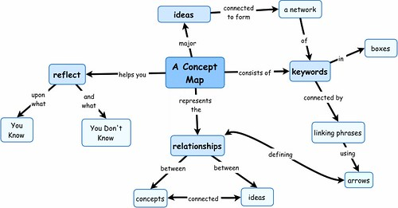
Active Studying – Maps, Diagrams, Organizers
Make connections between ideas using word webs or concept maps

Slide 9
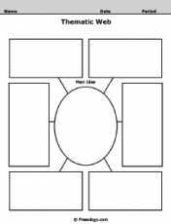
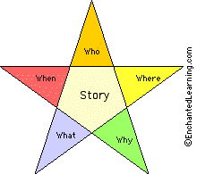
Active Studying
Make or find graphic organizers
Fill them in

Slide 10
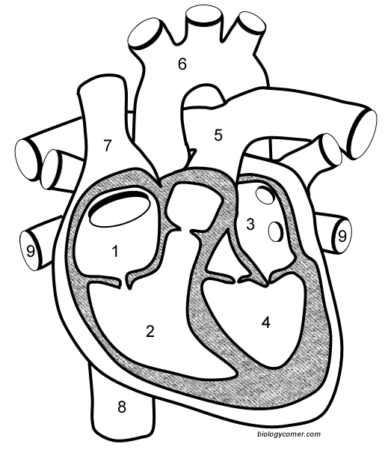
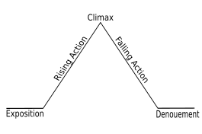
Active Studying
Label blank diagrams

Slide 11
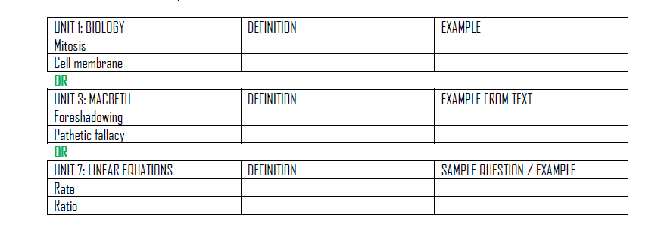
Active Studying
Make charts and fill them in
E.g., key vocabulary words
The 3rd column is the key! A way to jog your memory.

Slide 12
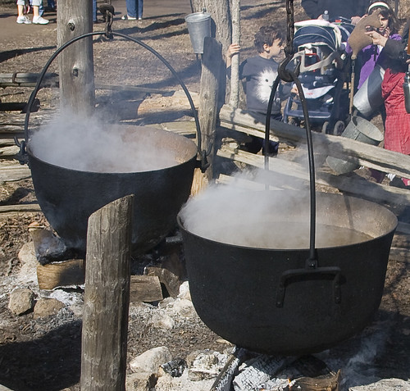
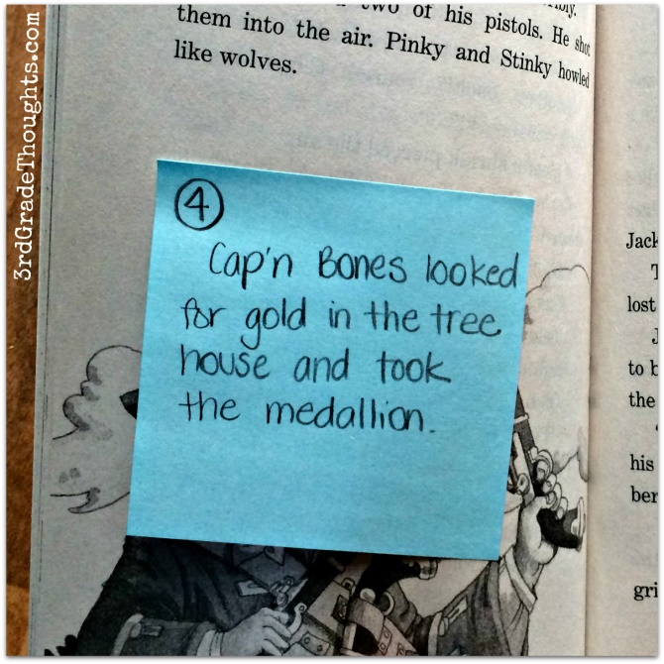
Summarize
Boil something big down to something small.

Slide 13
Memory Joggers
Crazy phrases for sequences
Lizards wrestle crunchy pretzels is a crazy phrase to help remember how to use this strategy:
List the information in order
Write the first letter from each word
Create a silly sentence whose words begin with these letters (should create a good mental image)
Practice the sentence until it’s fluent

Slide 14
Acronyms
Acronyms – each letter stands for something
BEDMAS (Order of operations)
Brackets
Exponents
Division
Multiplication
Addition
Subtraction
HOMES (Great Lakes)
Huron
Ontario
Michigan
Erie
Superior

Slide 15
Mnemonics
A phrase in which the first letter of each word represents something important.
Expressions
Names
Songs
My Very Easy Method Just Speeds Up Naming Planets
Never Eat Shredded Wheat

Slide 16
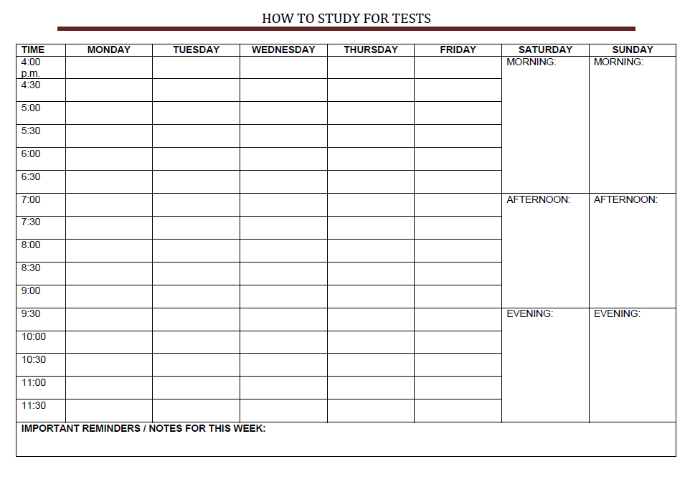
Plan Ahead

Slide 17
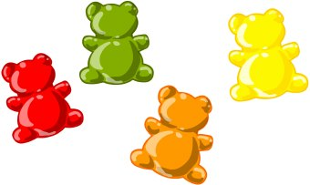
How Long Do I Study For?
Start yesterday!
The earlier the better
Don’t study straight for hours
Brain breaks are needed
Give yourself rewards
Rotate subjects

Slide 18
Will I Forget?
Not if you study actively
Forgetting is actually okay
It forces you to retrieve information from your brain so you LEARN it!

Slide 19
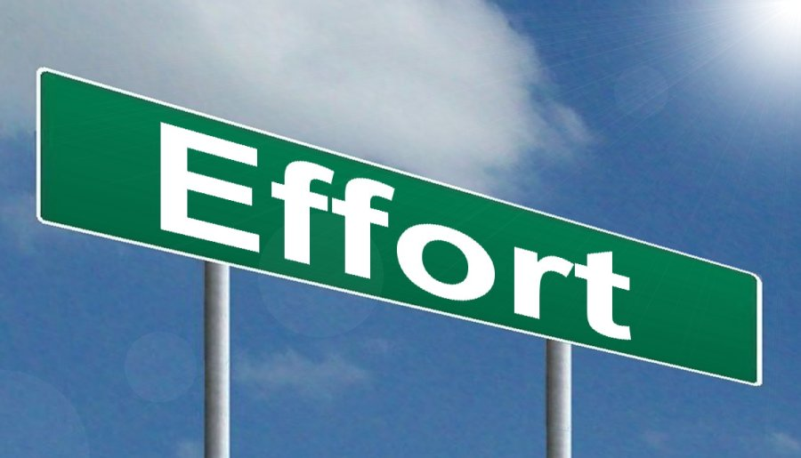
Overall
Effective
IS REQUIRED

