Slide 1
Paleolithic Society:
Advanced for its Time

Slide 2
Thematic Wall Blurb
Here you will explain how the upcoming objects will relate to the theme.

Slide 3
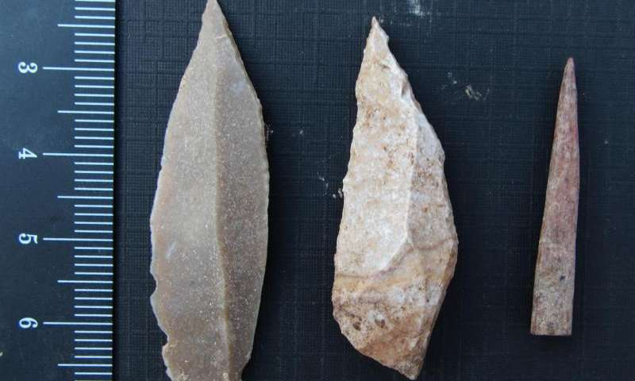
Developed Tools
Stone preserves much better than other materials so archaeologists are not entirely sure what other materials the Paleolithic people might have used, though animal bones, antlers and teeth were used as well. Common items such as choppers made of flaked stone were worked by humans for their needs. Later, prismatic blades were developed. They had long, narrow and sharp cutting points. They were so effective that the site in Jordan (Mughr el-Hamamah cave) where the tools were found suggests that the society organized around production of such tools, according to Liv Nilsson Stutz and Aaron Jonas Stutz. Thousands were found at the site. 2
Flaking of stones had probably been around for about 1.7 million years before these developments in sharpness occurred around 40 000 years ago. The fact that the society organized into roles for production of tools shows their social and technological advancement.
Continuity and change.
Left two objects: Stone tools from a cave in Jordan, dating to 44 000 to 42 000 years ago.1

Slide 4
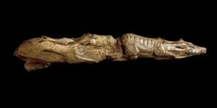
Sophisticated Artistry
The Paleolithic way of living, being nomadic and based on hunting and gathering, was quite different from ours. They probably shared what was hunted and what was gathered and probably all played a role in preparing the food and making use of animal bones and skin for clothing, tools and decorative objects. Moving from place to place following the animals and their seasonal migrations required an intimate knowledge of nature. The carved reindeer piece shows just how much the Paleolithic people were in tune with their natural surroundings. Carved onto a 27-centimetre long mammoth tusk about 11 000 years ago, the two swimming reindeer are said to be portrayed during the autumn, the time of year when humans made the best use of such animals. 4
Argument on advanced: Regardless, the artistry shows incredible awareness and agility.
HTC: Significance.
Swimming reindeer carved onto mammoth tusk, 11 000 years ago, France. 3

Slide 5
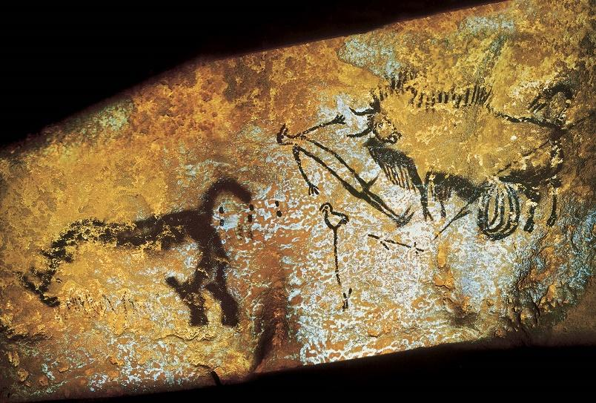
Thoughtful Cave Art
Paleolithic people created what we would call art. To them, objects and paintings may have held symbolic meaning. The most well known Paleolithic art comes from caves such as Lascaux in France, thought to be about 20 000 years old. The cave art is either painted on the cave walls with pigment (sprayed or brushed) or engraved into the stone. The most commonly represented animals are horses. There are also bulls and cows, bears, felines, bison, ibexes and aurochs. There are no plants or landscapes depicted. Their artistic techniques allowed them to show motion, such as a horse falling or rolling on the ground. One human figure was drawn in the whole cave – a stick figure with a bird-head. The artists may have used scaffolding to reach their painting or engraving locations. More than 100 animal-fat lamps have been found in the cave showing that this kind of tool was used to light the way into the deep recesses of the cave. 6
Argument Advanced:
HTC Perspective.
Bird-headed man with bison from Lascaux Cave, 20 000 years ago, France. 5

Slide 6
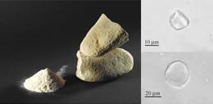
Gender Roles and Food
Though women may have done the bulk of gathering, anthropologists and archaeologists don’t think this would have been exclusive. Women may have participated in the hunts and men may have gathered as well. Gathering of plants, berries, seeds, roots and tubers (plus perhaps insects) did bring in much more of the calories that sustained the bands (about 70% according to some estimates). Some researchers believed that hunting was not uniformly done by using weapons but by using nets. Newly discovered evidence in Italy, Czech Republic and Russia also suggests that later Paleolithic people (around 30 000 years ago) ground some gathered plants and mixed them with water to make a bread-like substance. 8
Advanced tech arg
HTC Change
Paleolithic grinding tools. 7

Slide 7
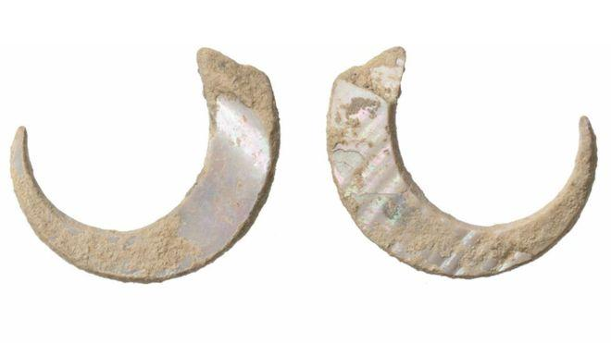
Fishing as an Advanced Technique
Having the ability to exploit marine life was a key strategy of paleolithic people yet little is known about how it was done. On the southern Japanese island of Okinawa this was even more important because there weren’t that many other resources. Evidence from Sakitari Cave suggests that paleolithic people surviving on Okinawa carved fish hooks out of snail shell.10
This shows advanced technology for the time because the paleolithic people were adapting to the marine environment and to the scarcity of other food sources on Okinawa. They came up with clever ideas of how to get food.
This relates to the historical thinking concept of continuity and change. Since these are the oldest fish hooks found (with the previous oldest dating to 16 000 years ago), they represent a change in technology, a new advance.
Recently, the oldest fish hooks have been found in Okinawa, Japan, dating to approximately 23 000 years ago. They are made from snail shells. 9

Slide 8
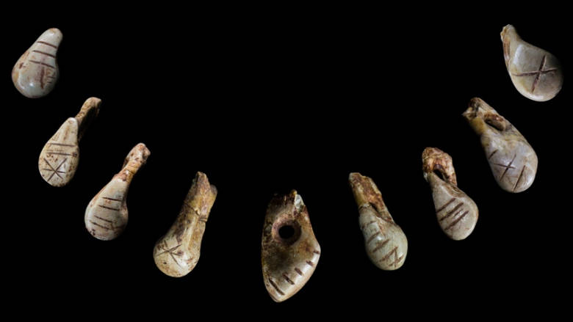
Signs as Proto Language
Canadian Anthropologist Genevieve von Petzinger believes that one of the earliest uses of proto-writing was in Paleolithic caves and sites where there seemed to be 23 signs and symbols commonly used. She has done the work of literaly connecting the dots – tracing the connections between signs and symbols used at different locations across Europe. The cave artists also created many geometric signs such as hooks, crosses, squares and lines of dots.12
This suggests the origin of a very advanced technology, writing. Though von Petzinger isn’t claiming that Paleolithic people in Europe write, she is suggesting that they communicated in a more complex form than previously thought. Many of her arguments are based on the repeated patterns found across European Paleolithic sites.
This relates to the historical thinking concept of continuity and change. Von Petzinger’s thesis is about the continuity between Paleolithic settlements, implying that they communicated in a common way. Their signs and symbols, whose meaning is unknown to us, show that their way of living was common across Europe, and thus continuous.
Part of a set of deer teeth carved with geometric symbols, 16 000 years ago, St. Germain la Riviere, France.11

Slide 9
Endnotes
1. Carol Clark, Stone Tools from Jordan Point to Dawn of the Division of Labor, Phys.org, Last modified June 12, 2015, https://phys.org/news/2015-06-stone-tools-jordan-dawn-division.html.
2. Ibid.
3. The British Museum, Collection Online: The Swimming Reindeer, Last modified 2017, http://www.britishmuseum.org/research/collection_online/collection_object_details.aspx?objectId=808748&partId=1.
4. Ibid.
5. University at Buffalo Library, Digital Collections, Bird-Headed Man with Bison, Accessed May 24, 2018, http://digital.lib.buffalo.edu/items/show/35518.
6. Ibid.
7. Ewen Callaway, Stone Age Flour Found Across Europe, Nature, Last modified Oct. 18, 2010, http://www.nature.com/news/2010/101018/full/news.2010.549.html.
8. Ibid.
9. World’s Oldest Fish Hooks Found in Japanese Island Cave, BBC, Last modified Sept. 18, 2016, http://www.bbc.com/news/world-asia-37402183.
10. Ibid.
11. CBC News, First Signs: Unlocking the Mystery of the World’s Oldest Symbols, Accessed Feb. 28, 2017, http://www.cbc.ca/radio/ideas/first-signs-unlocking-the-mysteries-of-the-world-s-oldest-symbols-1.3762393.
12. Ibid.

Slide 10
Bibliography

