Slide 1
What was worth fighting for? 1650-1789
rights
slavery
tolerance
intolerance
Unit 2
freedom
control

Slide 2
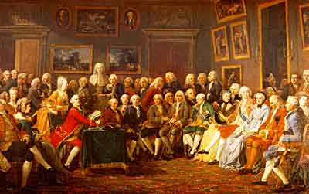
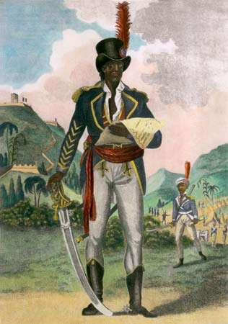
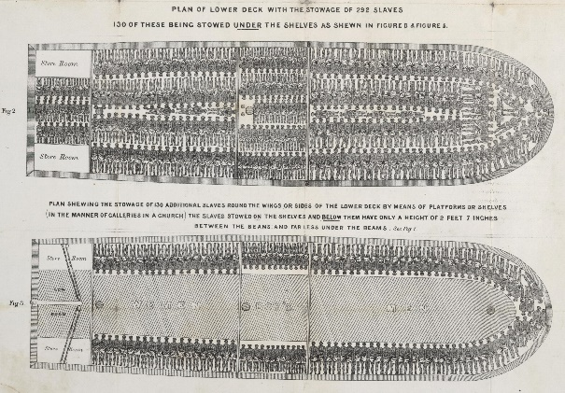
The Enlightenment [?]
CHY4U

Slide 3
Jean calas
According to the story, what was worth fighting for?
Broken on the wheel, 1762

Slide 4
Enlightened characteristics
Reason over tradition
Rational optimism
Freedom of thought over obedience to tradition
Rights
Tolerance
Individualism
Social criticism

Slide 5
All Good? No, very complex
“At its heart, the movement contained a paradox: Ideas of human freedom and individual rights took root in nations that held other human beings in bondage and were then in the process of exterminating native populations. Colonial domination and expropriation marched hand in hand with the spread of “liberty,” and liberalism arose alongside our modern notions of race and racism.”
Jamelle Bouie, “The Enlightenment’s Dark Side: How the Enlightenment created modern race thinking, and why we should confront it”, Slate, June 5, 2018, https://slate.com/news-and-politics/2018/06/taking-the-enlightenment-seriously-requires-talking-about-race.html

Slide 6
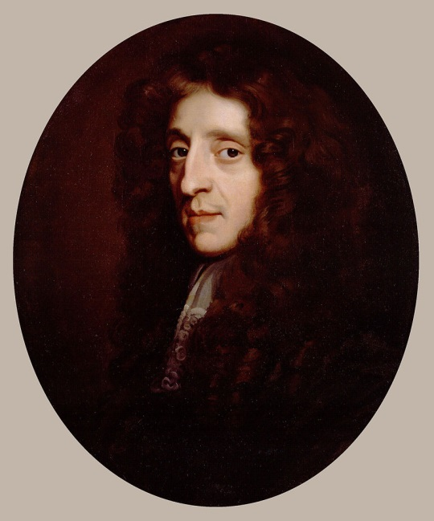
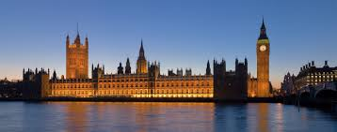
Locke
“life, liberty and property”

Slide 7
Social contract
Locke’s 2-way contract
The people form a contract with ________.
The ruler forms a contract with _________.

Slide 8
Locke takeup
__________ on authority
__________ liberties
__________ rights = LLP
Contract = ________________
State of __________________
Right to __________________

Slide 9
Political Systems
constitutional absolute monarchy monarchy
Like England
Like France
In the 1600s and 1700s neither was a democracy in which ordinary people could actually vote.

Slide 10
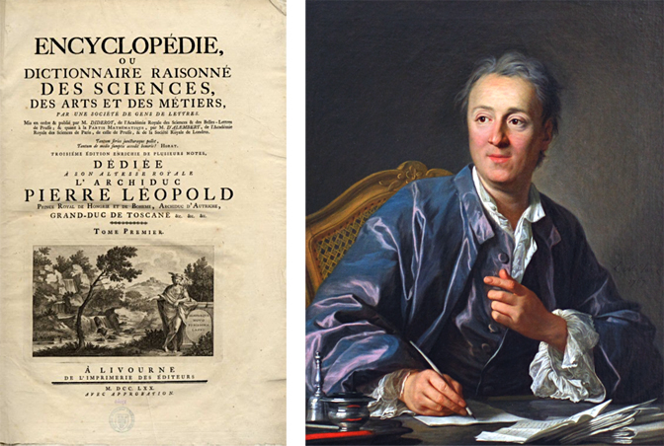
philosophes
Diderot

Slide 11
“intolerance” is blasphemous
“whoever is intolerant in this …sense is an evil man, a bad Christian, a dangerous subject, a poor statesman, and a bad citizen.”
“teaching, persuasion, and prayer, these are the only legitimate means of spreading the faith.”
“Conscience must be enlightened, not constrained.”
“It will take only three or four intolerant men to tear apart the entire fabric of society.”

Slide 12
Suggested textbook reading
pages 146-150:
Philosophes
Bayle
Diderot
Voltaire
Turgot
Hogarth
Rousseau
page 83 :
Locke

Slide 13
Match
Name | Detail
Bayle | A Attack privilege and question tradition
Diderot | B Genius is the key to progress and it’s only available in rational societies
Voltaire | C Passion and nature; society corrupts
Turgot | D Find evidence rather than accept things at face value
Rousseau | E Satirist of English corruption and greed
Hogarth | F Preferred English form of government or enlightened despotism

Slide 14
Rousseau Was Different
Philosophes | Rousseau
Progress | “man was born free, and everywhere he is in chains.”
 | State of nature preferred: “our minds have been corrupted in proportion as our arts and sciences have made advances toward their perfection.”
 | Lifelong theme: innocence vs. experience
Salons | Critical of salons
Individualism /scared of democracy | Community (general will) – dirty d?

