Slide 1
Becoming an Inquiry Teacher
Risa Gluskin
York Mills CI

Slide 2
Do I want to produce a thinker or a memorizer?
Does the atmosphere of my class support this endeavour?

Slide 3
Try an Inquiry (not a historical one)
The world seems like a good place to start an inquiry.

Slide 4
HTCs = Historical Thinking Concepts
They are the everyday vocabulary of my class
From day one of the course
They lend themselves naturally to critical thinking and inquiry
  Therefore, strand A is woven into everything I do:
    Assessment as and for learning
    Daily activities
    Assessment of learning
      Unit assignments
      Tests/quizzes
    Course culminating assignment and exam
Technically, design down starts here

Slide 5
HTC Concept Integration
Historical Significance
Causes and Consequences
Continuity and Change
(Primary) Evidence
Historical Perspectives
Ethical Dimensions of History
Notes:
5

Slide 6
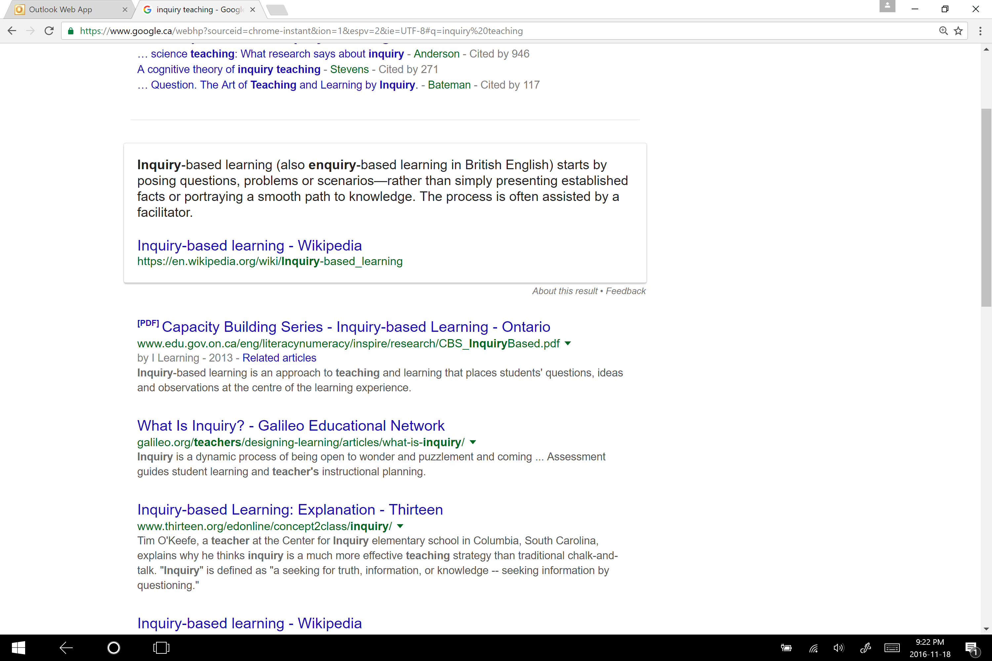
What Does Google Say?
Chris Meyer, science guru at my school, says: “teaching is not presenting”

Slide 7



Inquiry Skills – Not Necessarily in Order
Formulating questions
Gathering and organizing information, evidence, and/or data
Interpreting and analysing information, evidence, and/or data
Evaluating information, evidence, and/or data and drawing conclusions
Communicating findings and/or plans of action

Slide 8

Inquiry Questions
Inquiry …
  starts with good questions
    As Jill Colyer and Jennifer Watt write in IQ: A Practical Guide to Inquiry Based Learning, a good inquiry question is “an invitation to think (not recall, summarize, or detail).”

Slide 9

Deep vs. Surface Learning
Deep
Surface
Active
Critical thinking
Reflection
Student-centred
Passive
Memorization
Acceptance
Teacher-centred

Slide 10
21st Century Classroom
20th | 21st
Teachers control (managing) | Students take initiative (teachers facilitate)
Teachers present (yes, this includes our beloved PPTs) | Students engage in active learning
No computers in the classroom (or cell phones) | Tech is a daily part of class life (phones can be put to good use) [socrative]
Rows | Groups/pods for collaboration, stations

Slide 11
Edugains Says 21st Century Skills Are…
Engaging students as partners in their own learning
Harnessing the capacity of technology to engage learners and to optimize and amplify student learning and achievement
Creating more teacher-student learning partnerships through real world, authentic learning tasks enabled by technology
Emphasizing and teaching important higher-order skills such as critical thinking, communication, collaboration, creativity and entrepreneurship
Supporting educators in preparing our students for a rapidly changing, technology-driven, globalized world
Edugains. About 21st Century Learning in Ontario. 2016. http://www.edugains.ca/newsite/21stCenturyLearning/about_learning_in_ontario.html (Nov. 27, 2016)

Slide 12
Triangulation = 21st Century Ways of Assessing
Products
E.g., I assess students as they compare lessons learned from decolonization experiences in Algeria, Ghana, India, Kenya
Conversations
Observations

Slide 13

Less Is More
Emphasize why and how things happened rather than what
Let go of some of the details
Do more with less
Requires familiarity with curriculum expectations

Slide 14
“Research has found that inquiry-based activities can boost students’ learning in a wide range of school subjects. … However, the effectiveness of inquiry-based learning depends on the guidance provided by teachers. Unguided or minimally-guided inquiry may not work for students who have less previous knowledge or ability in the subject area. When the demands of the learning activities exceed students’ abilities, their learning is blocked and they may develop misunderstandings about the topic. Therefore, appropriate guidance must be incorporated into students’ inquiry learning. For example, teachers should guide students to develop a good question for investigation, monitor their inquiry process, and provide guidance when they encounter difficulties. Teachers should give students ongoing feedback and encourage them to constantly assess their own learning. Compared with having the teacher present all of the information, research offers clear evidence that teacher-guided inquiry works in the best interests of students and their learning.“
Canadian Education Association. Is Inquiry-Based Learning Effective. N.d. http://www.cea-ace.ca/sites/cea-ace.ca/files/cea_facts_on_ed_inquiry-based_learning.pdf (Nov. 26, 2016)

Slide 15
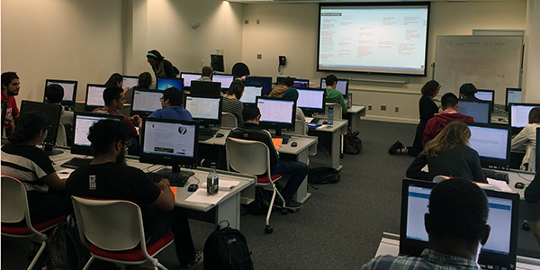
It’s not just sitting at a computer filling in worksheets
Use assessment as and for along the way to guide, get and give feedback

Slide 16
Research vs. Inquiry
“Inquiry-based teaching is a profound change from business as usual. Inquiry-based teaching transforms the aims of schools from short-term memorization of facts into disciplined questioning and investigating.” (Wolk, 2008, p. 117)
Research
Inquiry
Starting research is often the hardest part because there’s no guiding question

Slide 17
Lessons I’ve Learned
Do | Don’t
Question | Cover
Accept multiple answers | Think there’s only one answer
Focus on big ideas and documents | Focus on memorizing dates
Teach kids to ask questions | Provide all the answers
Use computer time for interesting, scaffolded purposes | Just stick the kids on the computer
Use worksheets/organizers as tools in the process of inquiry | Use worksheets/organizers as ends unto themselves

Slide 18
Who and/or What Makes
Historical Change?
(HTC = Causes and Consequences)
The placement of the X is up to each individual student based on their interpretation of the evidence
Individuals
X
Historical Conditions/Social Forces
Groups

Slide 19
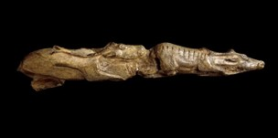
Introductory Unit (CHW3M)
Model Inquiry from Day One
Teacher-in-a-box (teaches inferencing)
Frink’s dig (in the shoes of an archaeologist)
Paleolithic reindeer carving (introduction to evidence, application of inferencing)
Paleolithic-Neolithic categorization activity (deductive reasoning)
  See http://gluskin.ca/chw3m-world-history/paleolithic-neolithic/

Slide 20
Traditional vs. Inquiry
Traditional lesson on Mayan sacrifices | Inquiry lesson on Mayan sacrifices
Overview History Reading and notes Some kind of application Question and answer worksheet | The night before ask students to read (no notes) something of their choice on the internet on Mayan sacrifice Put students in groups Have them share something they learned from their quick research (usually prompts good discussion) Group creates questions on sacrifice Class or group share on ethical concerns relating to sacrifice (HTC = ethical dimension) Have students individually weigh the evidence in a journal entry/reflection

Slide 21
Mayan Bloodletting Mini Inquiry
How Maya themselves saw bloodletting (*ethical concerns identified by students):
  Consensual – people agreed to it (*children, orphans, slaves, not nobles)
    Many children agreed to it because they were brought up in that climate
  Religiously motivated
    Pain was seen as something they give for the gods
      *Less pain for nobles
    They believed it would lead to good things
      Important if doom is coming
      *To keep nobles in power

Slide 22
Weighing the Evidence –
HTC Journal Entry
1. an unethical practice (ethical concerns are heaviest, even considering their own culture)
2. on the whole it is okay but there are some minor ethical concerns
3. an ethical practice (it was accepted in their society and we don’t have major ethical concerns)

Slide 23
Traditional lesson on Athenian democracy | Inquiry lesson Athenian democracy
Fill in worksheet/organizer with details from textbook Research each contributor to democracy Rank the contributors | Establish topic question (To what extent was Athens democratic?) Provide handout with information filled in (less detail than before) Students rank contributions to Athenian democracy and justify their choices using criteria
Traditional lesson on Greek women | Inquiry lesson on Greek women
Take textbook notes Compare to women in Canada and other civs studies | Read textbook section Make inferences from primary sources (vases with imagery related to women) Compare inferences to textbook information Apply inferences to primary source document by Aristotle on women End with questions for or about Aristotle’s view on women

Slide 24
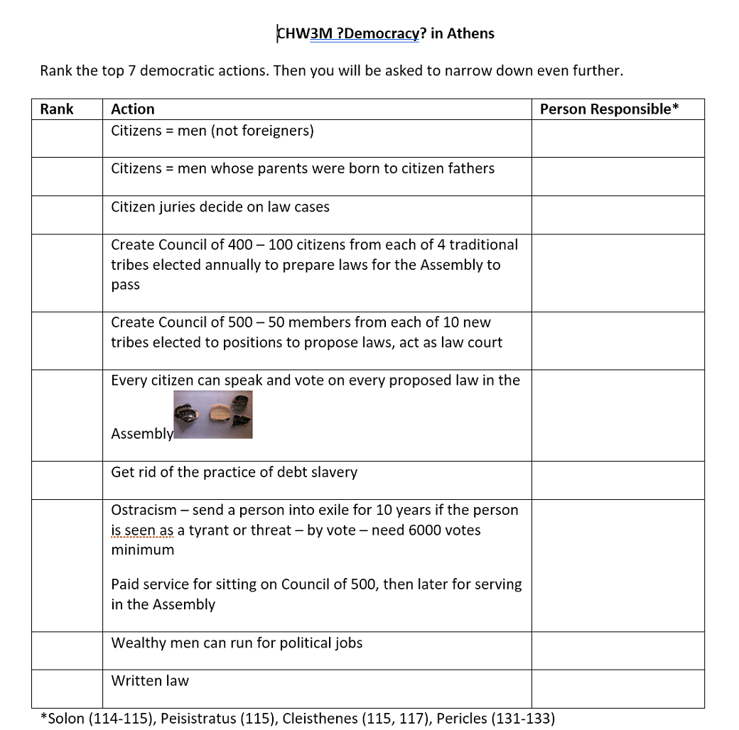



Slide 25
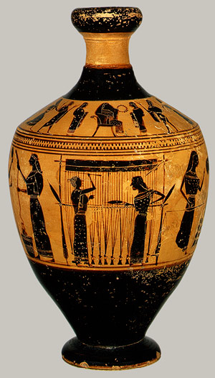
Ancient Greek Women
Discuss what inferences historians could make about Greek women based on 10 objects.
  Divide your inferences into these three categories:
      What is known for certain?
      What is probable?
      What is unsure (you are guessing)?
“Attributed to the Amasis Painter: Lekythos. (31.11.10)”. Heilbrunn Timeline of Art History. Metropolitan Museum of Art. 2000-. http://metmuseum.org/toah/works-of-art/31.11.10 (July 10, 2012).

Slide 26
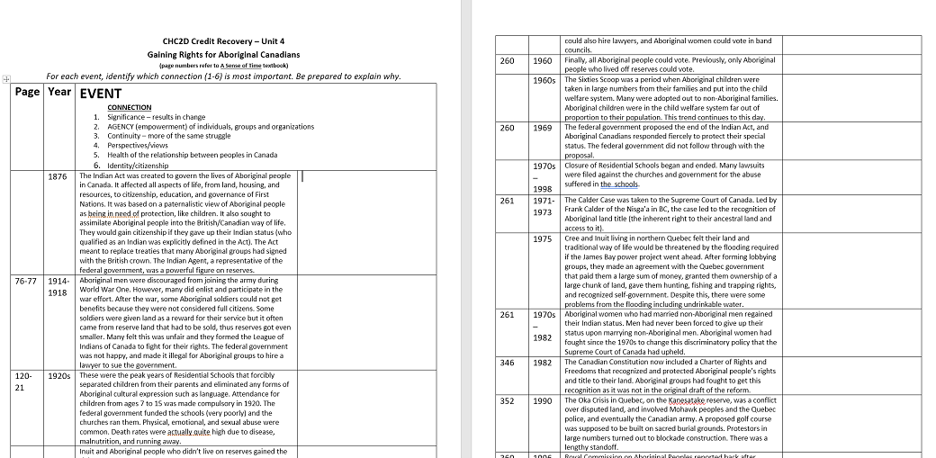
1876 – 2015 Timeline: Gaining Rights for Aboriginal Canadians
For each event/date, students identify which of the 6 themes it relates to:
Significance – results in change
Agency – improvements made by individuals, groups or organizations
Continuity – more of the same
Perspectives/views
Health of the relationship between people in Canada
Identity/citizenship
Then they choose the best example (most fitting) for each theme and explain the connection.
This activity would be better with a guiding question, such as “What would be the most appropriate way to describe the process of gaining rights for Aboriginal Canadians?”
  Need follow-up questions

Slide 27
Helpful Tools
A course question
  Eg., CHY4U: how did we get here?
Unit questions
  What were they thinking?
  What is worth fighting for?
  How was the world reshaped?
  Are we any better?
Frequent feedback (from teacher, peers, self) – Google classroom or a journal
3 part-lesson format
  Images / maps as minds on
Sitting in groups/pods
Using white boards or chart paper

Slide 28
Fears Addressed
Losing control
  Neat little rows and quiet students make me nervous = disengaged
Not having structure
  Increase students’ freedom (more in grade 12 than grade 10)
Noise
  It’s productive participation
Not knowing the answer
  You don’t have to – you all explore together and multiple answers are often possible (avoids a lot of multiple choice recall)

Slide 29
My Personal Challenges
Getting kids to develop good inquiry questions
Minimize or get rid of multiple choice questions on tests
Have all open book tests
  Forces me to ask really open-ended questions that require thinking
  Forces students to take good notes and invest in the unit because they can’t use their textbook
  Students have felt engaged by the questions
In the future I’d like to try a test-less semester
Group work tests (new primary source given to a group to examine for 10 minutes; individual follow-up [test or assessment] then occurs).

Slide 30
Next Step
Go forth and stand on the side of your class!

