Slide 1
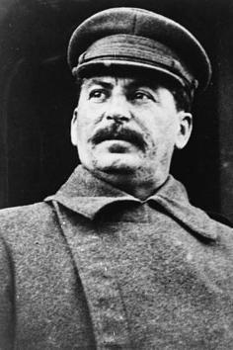
Stalin’s Industrial Crusade
CHY4U, Unit 4, Activity 4

Slide 2
Collectivization of Agriculture
Peasants were criticized by Stalin for having low membership in the Communist Party and not producing enough food to feed the industrializing cities
Kulaks (so called ‘rich’ peasants who weren’t rich at all) were treated incredibly harshly, including being deported to Siberia and having their land confiscated to the collective farms
Kolkhoz = collective farms where 50 to 100 families pooled their fields, horses, and tools

Slide 3
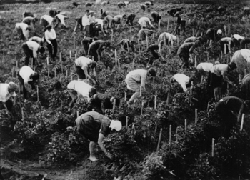
Collective farmers picking tomatoes outside Moscow.
Yale University, Annals of Communism, Stalinism as a Way of Life: A Narrative in Documents, N.d., http://www.yale.edu/annals/siegelbaum/images/siegelbaum_photos.htm (May 27, 2013).

Slide 4
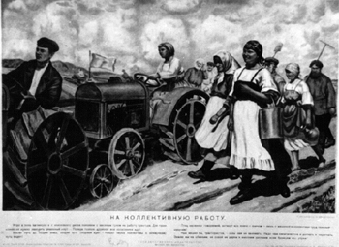
Soviet Poster: Off to Collective Work.
Ibid.

Slide 5
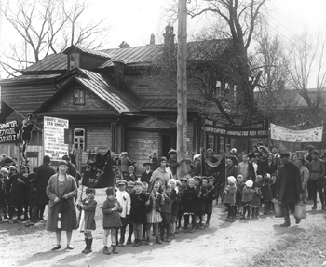
Banners say: "We will liquidate the kulaks as a class" and "All to the struggle against the wreckers of agriculture."
Ibid.

Slide 6
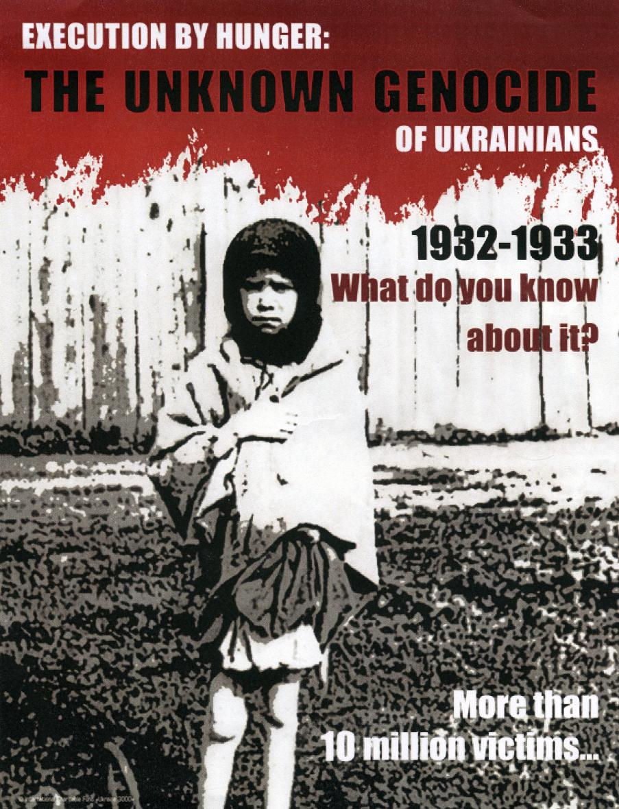
Holodomor
Ukrainian man=made famine
Stalin raised the amount of
grain the Ukraine was
supposed to supply to the
state (the USSR) by 44%
5-10 million dead
Ukrainian Genocide Famine Foundation, 75th Anniversary of the Ukrainian Genocide Online Exhibition, 2008, http://www.ukrainiangenocide.org/75th_Exhibit_Page_0.html (May 27, 2013).
Ukrainian Genocide poster.

Slide 7
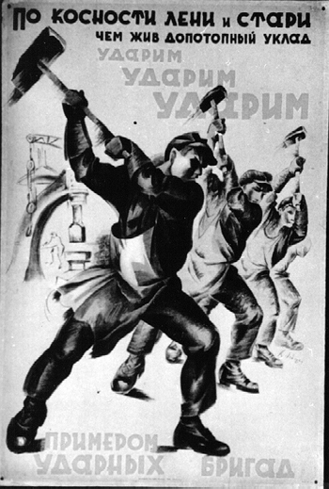
Industrialization
5-Year Plans
Heavy industry to triple in
output so Soviet Union could
compete with the west
Central planning = command
economy (everything from
hours, wages, prices controlled
by the government)
Soviet poster against the old life of laziness.

Slide 8
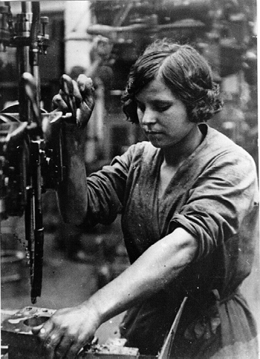
Woman industrial worker.
Ibid.

