Slide 1
Imperialism
CHY4U, Ms. Gluskin
April/May 2020

Slide 2
Technology First
Please look at page 38 in unit 3 handouts: Nineteenth Century Firsts Timeline. Identify what you think the most important 3 technologies would have been to enable imperialism and re-shape the world.
Technology enabled imperialism.

Slide 3
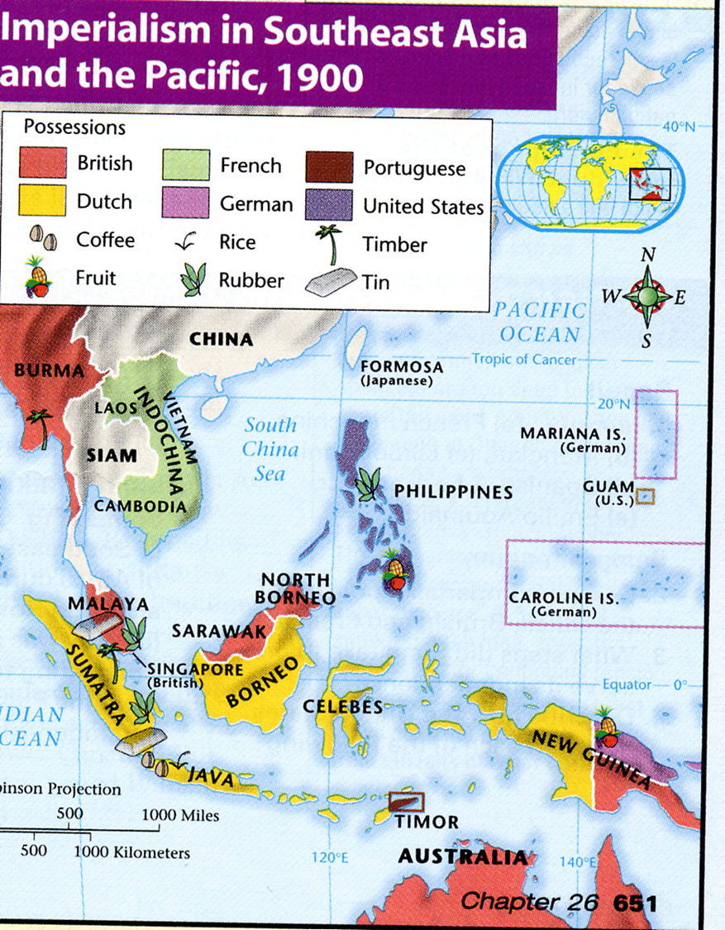
Three Motivations for Imperialism
1. economic (resources, labour, markets)
2. national prestige (other countries have colonies – why not us?)
3. conversion to Christianity

Slide 4
What is Imperialism?
Having an empire
Adding territory to a country
“ policy of extending a country's power and influence through diplomacy or military force.” (Oxford Dictionary)

Slide 5
The Boxes Analogy of Imperialism
On the next slide you will see a map of the Russian Empire in the 1800s from the 1912 Cambridge Atlas of Modern History.
Source: https://etc.usf.edu/maps/pages/7600/7644/7644.htm
We will use it to learn the boxes analogy of imperialism. The map shows the extent of the empire. The boxes view, on the following slide, shows the different parts of the empire.

Slide 6
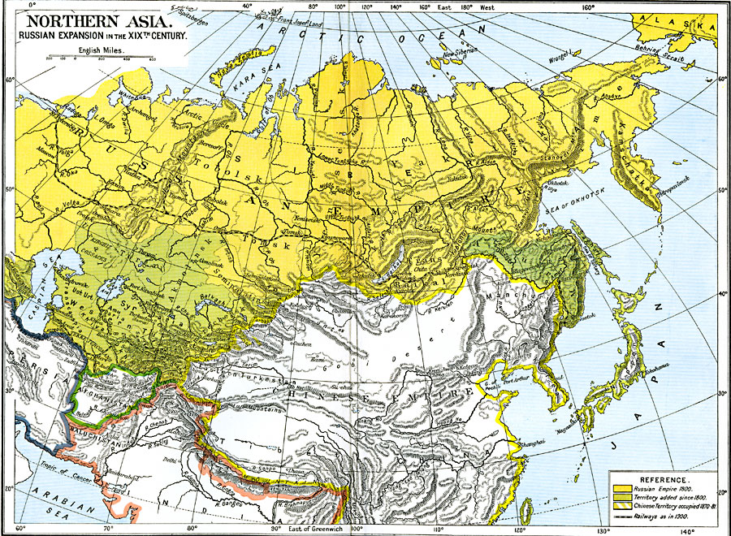

Slide 7
*Russia
Moldova
Ukraine
Belarus
Georgia
Parts of Poland
Finland
Armenia
Turkestan
Siberia
Kamchatka
Lithuania
* The mother country in the sense that it was the centre from which territory was expanded outward.

Slide 8
Nationalism – Two Sides of a Coin
Nationalism and Imperialism
Empires like Russia, Austria-Hungary, Ottomans, and Britain control a lot of territory. People in the mother-country (Russia, Austria, Turkey) might have a lot of pride and nationalism in the fact that their empire is so big. However, people in the parts of the empire (colonies) might feel otherwise; some may want to have independence for themselves and/or the right to speak their own language and practice their own culture.

Slide 9
Two Perspectives on Imperialism
On the next 2 slides you will see 2 different perspectives on imperialism.

Slide 10
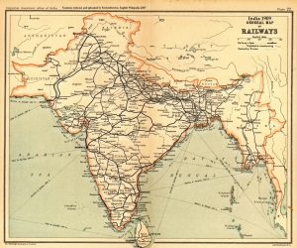
Source 1: 1909 Map of Railways in India (part of the British Empire)
from a British atlas
From the perspective of the British, what kind of benefits would imperialism have brought to India?

Slide 11
Source 2: Indian Nationalist (anti-imperialist) Bal Gangadhar Tilak
Tilak addressing the Indian National Congress in 1907:
“One thing is granted, namely, that this government does not suit us. As has been said by an eminent statesman – the government of one country by another can never be a successful, and therefore, a permanent government. …One fact is that this alien government has ruined the country. In the beginning, all of us were taken by surprise. We were almost dazed. We thought that everything that the rulers did was for our good …We are not armed, and there is no necessity for arms either. We have a stronger weapon, a political weapon, in boycott. We have perceived one fact, that the whole of this administration, which is carried on by a handful of Englishmen, is carried on with our assistance. We are all in subordinate service. … I want to have the key of my house, and not merely one stranger turned out of it. Self-government is our goal; we want a control over our administrative machinery. We don’t want to become clerks and remain [clerks]. At present, we are clerks and willing instruments of our own oppression in the hands of an alien government, and that government is ruling over us not by its innate strength but by keeping us in ignorance and blindness to the perception of this fact.”
From the perspective of an Indian nationalist, what are the drawbacks of imperialism?

Slide 12
Imperialism in Maps
Now let’s look at some maps to help us ask interesting questions about imperialism.
See Imperialism in Maps on the blog or the Google Classroom.

