Slide 1
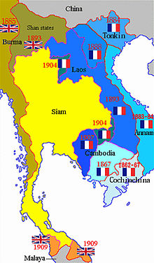
Vietnam’s Decolonization
CHY4U
.

Slide 2
Before the Vietnam War?
The history of Vietnam is more than the story of the Vietnam War. In fact, there were multiple wars before THE Vietnam War:
They were:
Vietminh (nationalists) vs. Japan
Vietminh vs. France
3. Vietnamese vs. Vietnamese (later in the 1960s and 70s)

Slide 3
French Indochina
France’s colonial possession since 1880s
Economic: large plantations of rice, rubber
Other industries: mining coal, tin, zinc
Workers on plantations were forced, paid low wages, suffered a lot
Heavy taxes on Vietnamese people, mostly peasants
Politically France was aided by a small group of local allies (or collaborators) who were pro-French, including the figurehead emperor’s family
Vietnamese unity was discouraged by creating provinces rather than allowing a national identity to flourish

Slide 4
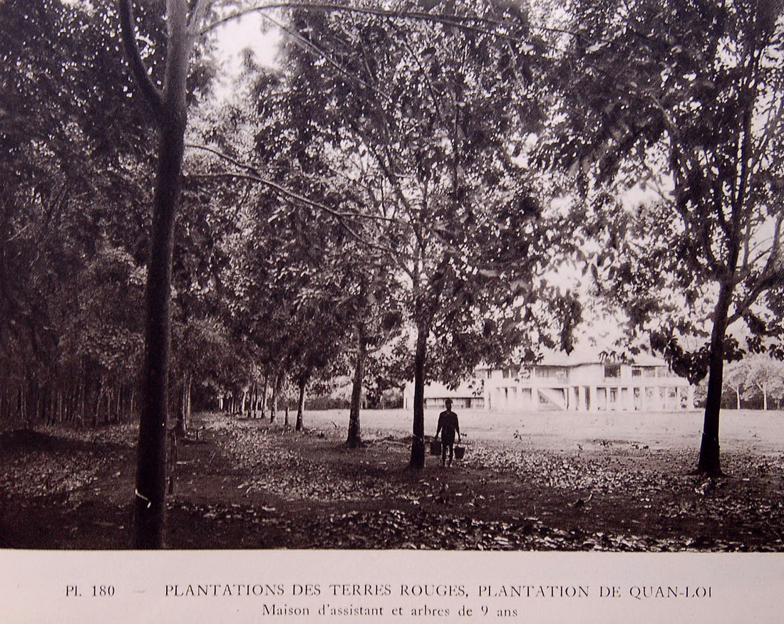

Slide 5
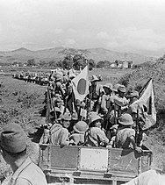
Decolonization Context
Japanese imperialism is over
The Japanese had invaded Indochina in 1940
At the time, France had just been invaded by Nazi Germany and thus the French administration in Vietnam was very weak
The Japanese ruled through the former French administration (not in place of it)
Vietnamese nationalists overthrew the Japanese in 1945
French imperialism is (sort of ) over
The French returned in 1946 and fought until 1954 to hold on to Vietnam (eventually they lost).
https://en.wikipedia.org/wiki/Japanese_invasion_of_French_Indochina

Slide 6
Americans in Asia
During Japanese rule the Americans helped the nationalists (Viet Minh) under Ho Chi Minh.
America was at war with Japan so it was happy to help the Vietnamese fight against Japan.
It should also be noted that at this time the Americans were also funding the Chinese Nationalists fighting a civil war against the Chinese Communists since the 1930s. (Note: The Communists did not win that war until 1949.)

Slide 7
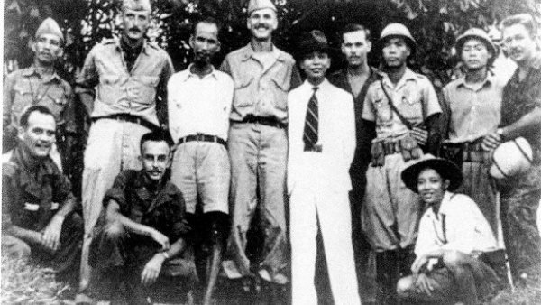
Ho Chi Minh with American intelligence officers in August 1945.
https://www.cfr.org/blog/remembering-ho-chi-minhs-1945-declaration-vietnams-independence

Slide 8
Vietnamese Independence?
As the Viet Minh fought the Japanese, they consolidated their base in the north of Vietnam.
Eventually they, under Ho, sought independence for Vietnam, thinking the US would support them.

Slide 9
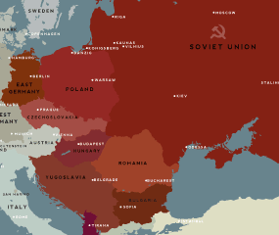
Cold War Context
The cold (or ideological) war between the democratic / capitalist US and the communist and authoritarian USSR began even before the end of WWII.
At the end of WWII, there were 10 million Soviet troops occupying half of Europe.
http://www.pbs.org/behindcloseddoors/maps/index.html

Slide 10
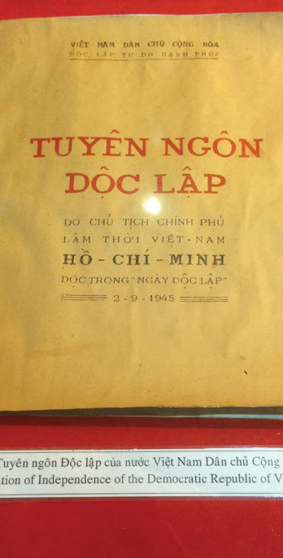
Exam Questions
I will give you a PSD related to Vietnam’s decolonization on the exam.
Be prepared to relate it to other case studies of imperialism/decolonization.

