Slide 1
China and Imperialism: Day 2: Perspectives on the Opium Wars
CHY4U
Unit 3, May 2020

Slide 2
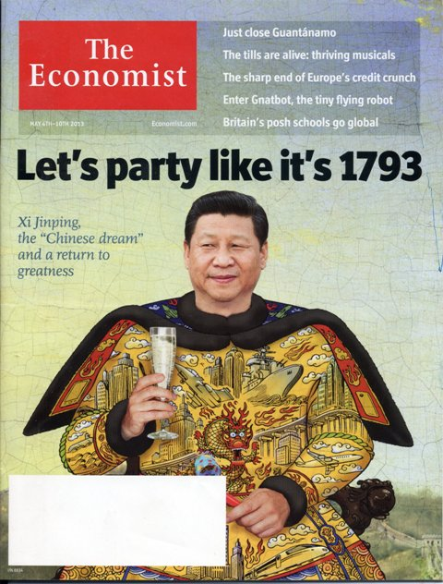
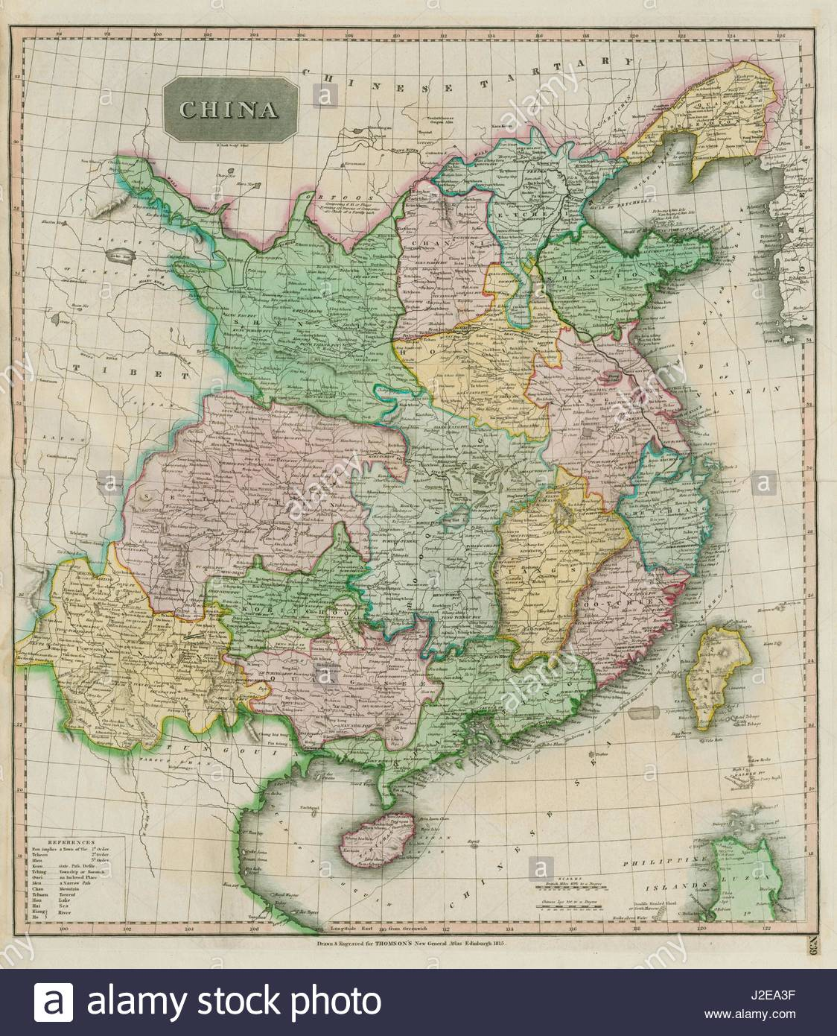
Good Old Times?
Why does the current Chinese leader want to party like it’s 1793?
China was a large, rich and powerful country in 1793

Slide 3
So, how did China go from the power of 1793 to the humiliation of imperialism?

Slide 4
Imperial Powers in China
Elisabeth Gaynor Ellis and Anthony Esler, World History: Connections to Today – Teachers Edition (Upper Saddle River, New Jersey: Prentice Hall, 2001), 638.

Slide 5
Opium Wars

Slide 6
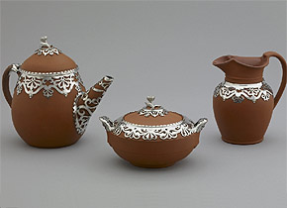
Tea and …
By the 19th century, tea had become a central aspect of British life. The large scale importation of tea, sugar, and chocolate changed English diets; breakfast, for example, changed dramatically during this time period due to the influx of these goods. According to Columbia University’s Asia for Educators, a website designed to serve faculty and students in world history, the average worker in London spent approximately 5% of their total household budget on tea. Comparatively few British goods entered Chinese ports, because, as we saw previously, the Chinese did not need European goods and were dismissive of them. This created a considerable trade imbalance; large amounts of silver were flowing out of British cities into China.
BBC, A History of the World, “Early Victorian Tea Set,” 2014, http://www.bbc.co.uk/ahistoryoftheworld/objects/FWYgWOCSSpKKuF3pctC6tA

Slide 7
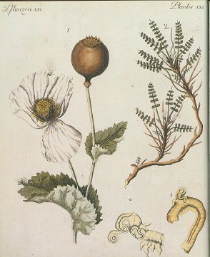
… Opium
To address this trade imbalance, the East India Trading Company smuggled opium from British-controlled India to Chinese ports. Despite the fact that the Chinese Emperor banned the import of opium in 1799, the smuggling continued. By 1804, British trade of tea and opium was at a surplus. By 1838, millions of Chinese people were opium addicts.
Royal Pharmaceutical Journal, “Pain Relief: Designing Better Opioids”, April 19, 2018, https://www.pharmaceutical-journal.com/news-and-analysis/features/pain-relief-designing-better-opioids/20204708.article?firstPass=false

Slide 8
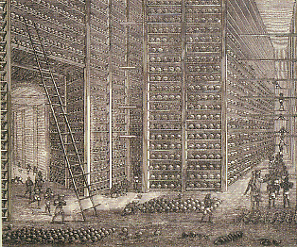
Opium Processed in India
The Stacking Room
The Drying Room
"The Indo-Chinese Opium Trade: Notes at an Opium Factory at Patna." Source: drawings by Lieut.-Colonel Walter S. Sherwill, The Graphic, 24 June 1882, p. 640.
University of Victoria, “Chinatown: Opium,” Nd., Accessed May 8, 2020, https://web.uvic.ca/vv/student/chinatown/opium/p1.htm

Slide 9
Lin Zexu Letter to Queen Victoria
In 1838, Lin Zexu, the Governor-General of Hunan and Hubei, was commissioned by the central government in Beijing to try to deal with the problem. Below is a short excerpt of a letter he wrote to Queen Victoria.
I am told that in your own country opium smoking is forbidden under severe penalties. This means that you are aware of how harmful it is. . . . So long as you do not take it yourselves, but continue to make it and tempt the people of China to buy it, you will be showing yourselves careful of your own lives, but careless of the lives of other people, indifferent in your greed for gain to the harm you do to others; such conduct is repugnant to human feeling and at variance with the Way of Heaven. . . . .
On receiving this, Your Majesty will be so good as to report to me immediately on the steps that have been taken at each of your ports.
Source: Victorian Web, Commissioner Lin Ze-xu's Letter to Queen Victoria. 2006. http://www.victorianweb.org/history/empire/opiumwars/lin.html (Jan. 27, 2016)

Slide 10
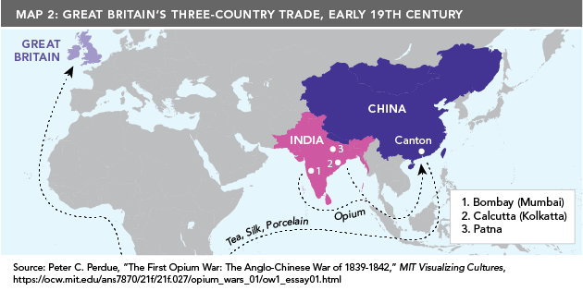
What were his motivations and rationale for writing the letter?
New World Encyclopedia, “Lin Zexu,” Nd., Accessed May 8, 2020, https://www.newworldencyclopedia.org/entry/Lin_Zexu; Asia Pacific Foundation of Canada, Asia Pacific Curriculum, “The Opium Wars in China,” 2020, https://asiapacificcurriculum.ca/learning-module/opium-wars-china

Slide 11
Opium Imports to China
“The Chinese government recognized that opium was becoming a serious social problem and, in the year 1800, it banned both the production and the importation of opium. In 1813, it went a step further by outlawing the smoking of opium and imposing a punishment of beating offenders 100 times.” Lin Zexu argued it was a moral issue and arrested a lot of dealers. He eventually had the opium destroyed. How do you think British opium merchants felt about this? Whom would they petition for redress?
1810 | 1838
4500 chests | 40 000 chests
Asia Pacific Foundation of Canada, Asia Pacific Curriculum, “The Opium Wars in China,” 2020, https://asiapacificcurriculum.ca/learning-module/opium-wars-china

Slide 12
War Began in 1839
Destroying Chinese war junks, by British painter, Edward Duncan (1843). This painting depicts British ironclad vessels (background) destroying Chinese vessels. China, once the most technologically advanced place in the world, had fallen behind and could not compete.
https://commons.wikimedia.org/wiki/File:Destroying_Chinese_war_junks,_by_E._Duncan_(1843).jpg

Slide 13
War Ended in 1842
The Treaty of Nanjing
Article II
His Majesty the Emperor of China agrees that British Subjects, with their families and establishments, shall be allowed to reside, for the purpose of carrying on their commercial pursuits, without molestation or restraint at the Cities and Towns of Canton, Amoy, Foochowfu, Ningpo, and Shanghai, and …
Article III
It being obviously necessary and desirable, that British Subjects should have some Port whereat they may careen and refit their Ships, when required, and keep Stores for that purpose, His Majesty the Emperor of China cedes to Her Majesty the Queen of Great Britain, etc., the Island of Hong‑Kong, to be possessed in perpetuity by her Britannic Majesty, Her Heirs and Successors, and to be governed by such Laws and Regulations as Her Majesty the Queen of Great Britain, etc., shall see fit to direct.
Asia for Educators, “Excerpts from the Treaty of Nanjing, August 1842,” Nd., http://afe.easia.columbia.edu/ps/china/nanjing.pdf

Slide 14
Article V
The Government of China having compelled the British Merchants trading at Canton1 to deal exclusively with certain Chinese Merchants called Hong merchants (or Cohong) who had been licensed by the Chinese Government for that purpose, the Emperor of China agrees to abolish that practice in future at all Ports where British Merchants may reside, and to permit them to carry on their mercantile transactions with whatever persons they please, and His Imperial
Majesty further agrees to pay to the British Government the sum of Three Millions of Dollars, on account of Debts due to British Subjects by some of the said Hong Merchants (or Cohong) who have become insolvent, and who owe very large sums of money to Subjects of Her Britannic Majesty.
Article VII
It is agreed that the Total amount of Twenty‑one Millions of Dollars, described in the three preceding Articles, shall be paid as follows:
Six Millions immediately.
Six Millions in 1843 …
Five Millions in 1844 …
Four Millions in 1845 …
Ibid.

Slide 15
Treaty Questions
In China, (and in many Western texts), the Treaty of Nanjing is called the first of the “unequal treaties.” Is the term “unequal treaty” justified by the content and wording of the treaty?
On the British side, whose interests are best served by this treaty? In other words, who or what kind of people stand to gain?
Are there Chinese who might gain something from some of the terms of this treaty? Explain.

Slide 16
Foreshadowing?
How might this treaty foreshadow the future of China?
Note: there was a Second Opium War from 1856 to 1860. More to come on that…

