Slide 1
China And Imperialism: Day 1 - Context
CHY4U
Unit 3, May 2020

Slide 2
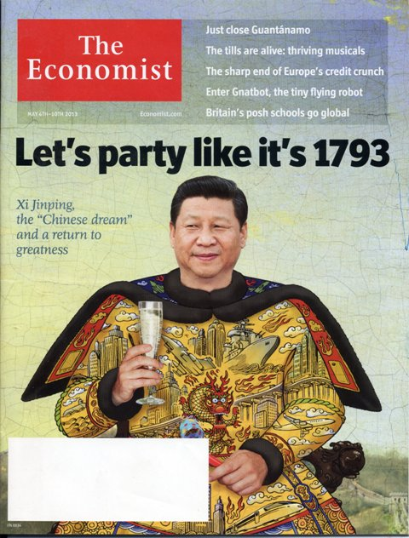
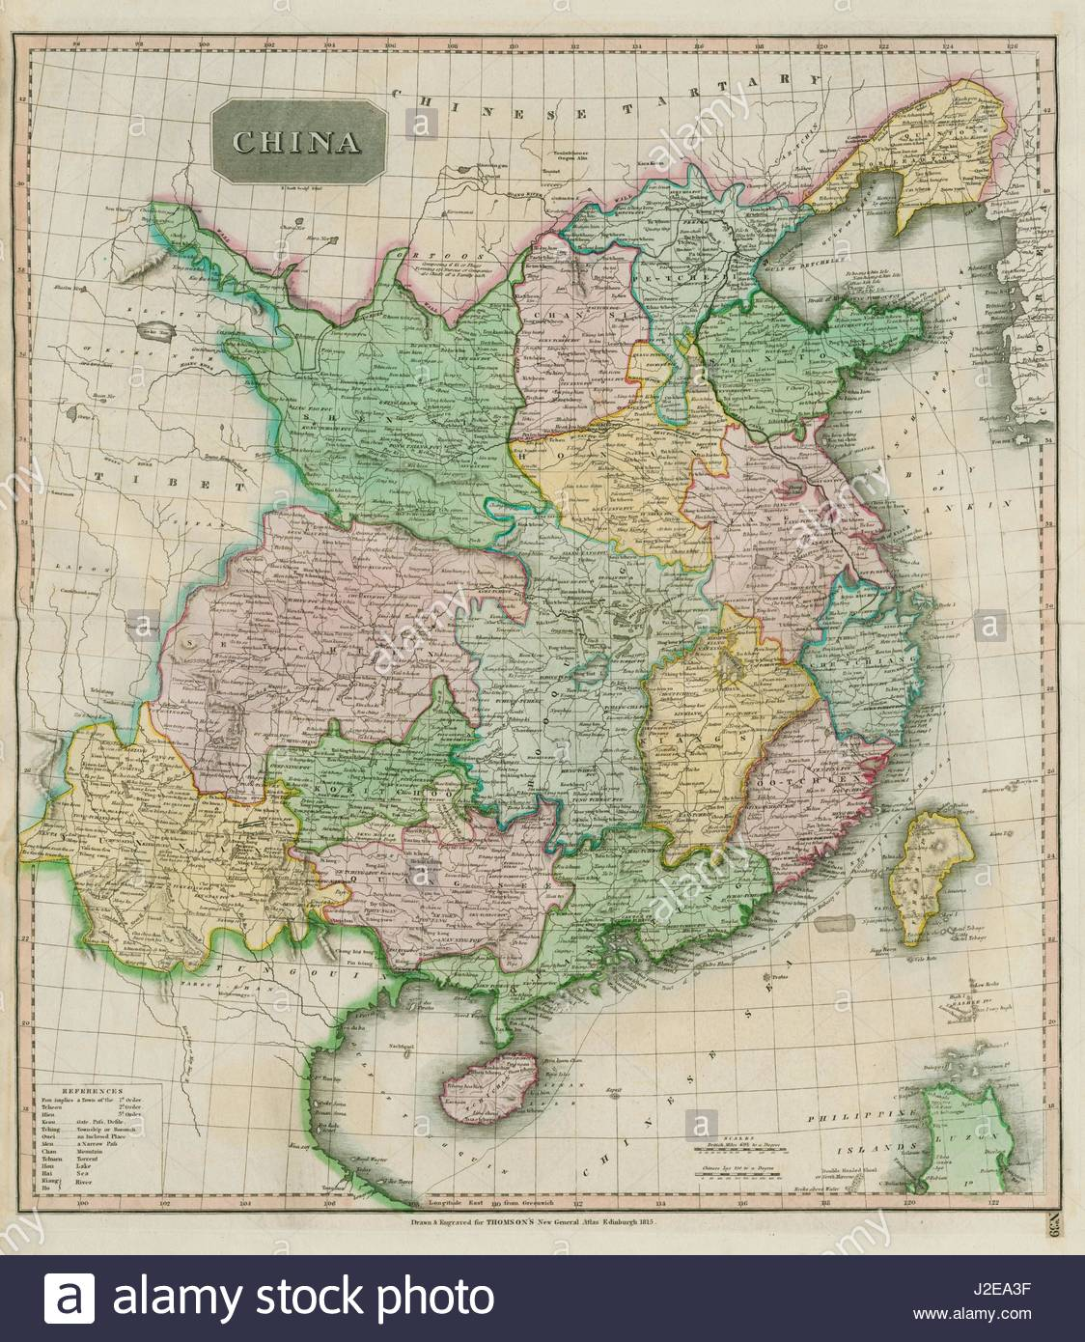
Good Old Times?
Why does the current Chinese leader want to party like it’s 1793?
China was a large, rich and powerful country in 1793

Slide 3
Background
“Many Europeans had contact with China over the centuries. When Marco Polo traveled to China in the thirteenth century, he found European artisans already at the court of the Great Khan. In the sixteenth and seventeenth centuries, priests such as the Italian Matteo Ricci journeyed to China, learned Chinese, and tried to make their religion more acceptable to the Chinese. These contacts were made usually by individual entrepreneurs or solitary missionaries. Although some Western science, art, and architecture was welcomed by the Qing court, attempts to convert Chinese to Christianity were by and large unsuccessful. More importantly, the Chinese state did not lend its support to creating a significant number of specialists in Western thinking.”
Asia for Educators, “Macartney and the Emperor,” 2009, http://afe.easia.columbia.edu/special/china_1750_macartney.htm

Slide 4
Controls?
As you read the next slide, identify the controls that the Chinese government put on trade.
Then, predict how countries like Britain (who have growing empires and say they favour free trade) would react to the Chinese controls on trade.
Note: remember the economic motivations for imperialism – resources, labour, markets

Slide 5
“Direct oceanic trade between China and Europe began during the sixteenth century. At first it was dominated by the Portuguese and the Spanish, who brought silver from the Americas to exchange for Chinese silks. Later they were joined by the British and the Dutch. Initially trading took place at several ports along the Chinese coast, but gradually the state limited Western trade to the southern port of Canton (Guangzhou). Here there were wealthy Chinese merchants who had been given monopoly privileges by the emperor to trade with foreigners. Merchant guilds trading with foreigners were known as "hongs," a Westernization of hang, or street. The original merchant associations had been organized by streets. The merchants of the selected hongs were also among the only Chinese merchants with enough money to buy large amounts of goods produced inland and have them ready for the foreign traders when they came once a year to make their purchases. The Chinese court also favored trading at one port because it could more easily collect taxes on the goods traded if all trade was carried on in one place under the supervision of an official appointed by the emperor. Such a system would make it easier to control the activities of the foreigners as well. So in the 1750s trade was restricted to Canton (Guangzhou), and foreigners coming to China in their sail-powered ships were allowed to reside only on the island of Macao as they awaited favorable winds to return home.”
Ibid.

Slide 6
Excerpt from Chinese Emperor Writing to George III, 1793
You, O King from afar, have yearned after the blessings of our civilization, and in your eagerness to come into touch with our converting influence have sent an Embassy across the sea bearing a memorial. I have already taken note of your respectful spirit of submission, have treated your mission with extreme favour and loaded it with gifts, besides issuing a mandate to you, O King, and honouring you with the bestowal of valuable presents. Thus has my indulgence been manifested. …
Hitherto, all European nations, including your own country’s barbarian merchants, have carried on their trade with Our Celestial Empire at Canton. Such has been the procedure for many years, although Our Celestial Empire possesses all things in prolific abundance and lacks no product within its borders. There was therefore no need to import the manufactures of outside barbarians in exchange for our own produce. But as the tea, silk, and porcelain which the Celestial Empire produces are absolute necessities to European nations and to yourselves, we have permitted, as a signal mark of favour, that foreign [trading spots] should be established at Canton, so that your wants might be supplied and your country thus participate in our beneficence. But your Ambassador has now put forward new requests which completely fail to recognize the Throne’s principle to “treat strangers from afar with indulgence,” and to exercise a pacifying control over barbarian tribes, the world over. …
Source: Asia for Educators, Qianlong Exercises, N.d. http://afe.easia.columbia.edu/ps/china/qianlong_edicts.pdf (Jan. 23, 2017)

Slide 7
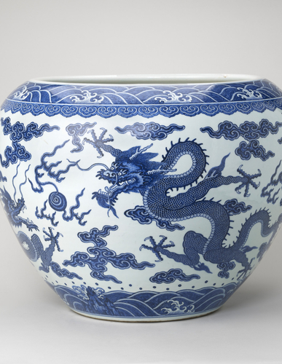
Questions on 1793 Letter
What can you infer about the emperor’s view of western goods and ideas?
Based on what you’ve learned in the course so far, is the king of England likely to have had the same perspective as the emperor? Why or why not?
Note tone of Chinese superiority = Sino-centrism (like Eurocentrism)
Chinese porcelain
Royal Collection Trust, JINGDEZHEN [JIANGXI PROVINCE, CHINA] Jardinière mark and reign of Qianlong, 1736-95, Accessed May 7, 2020, https://www.rct.uk/collection/themes/trails/the-macartney-embassy-gifts-exchanged-between-george-iii-and-the-qianlong-4

Slide 8
So, how did China go from the power of 1793 to the humiliation of imperialism? Stay tuned for tomorrow’s lesson.

Slide 9
Imperial Powers in China
Elisabeth Gaynor Ellis and Anthony Esler, World History: Connections to Today – Teachers Edition (Upper Saddle River, New Jersey: Prentice Hall, 2001), 638.

