Slide 1
The Mongols in China
CHW3M
What happened to Chinese stability?
Who was progressing, who was declining under Mongol rule?

Slide 2
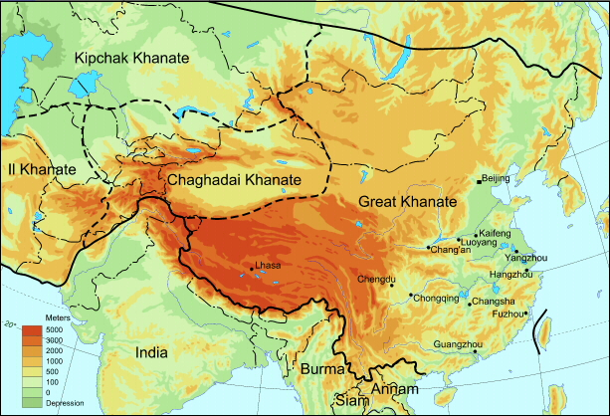
Map of Mongol Empire
University of Washington, A Visual Sourcebook of Chinese Civilization, N.d.,
https://depts.washington.edu/chinaciv/1xaryuan.htm (April 28, 2015)

Slide 3
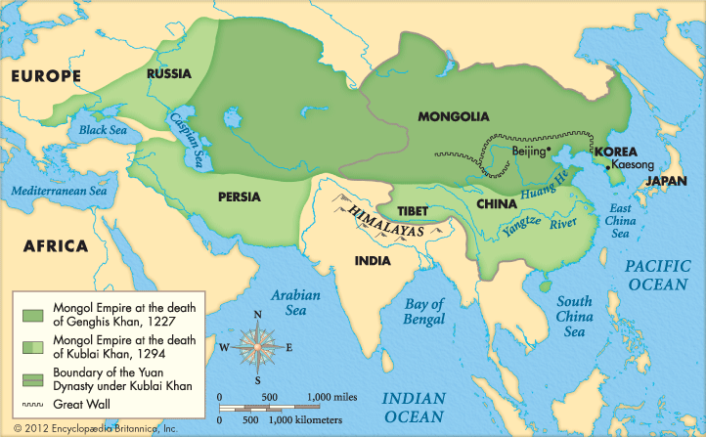
Expansion Over Time
Encyclopedia Britannica Kids, Ghengis Khan, Mongol Empire, 2015, http://kids.britannica.com/elementary/art-88146 (April 28, 2015)

Slide 4
How Did They Expand So Much?
Military Strengths
Horsehide armour hardened in urine
2 crossbows per horseman, could go a distance of 180m (farther than any other at the time) – shoot backwards
3 horses per man – for endurance and survival on long distance rides (remounts too)
Catapult missiles (with diseased animal and human corpses)
Drank horse blood and milk
Women picked up arrows after battles for re-use
http://asianhistory.about.com/od/profilesofasianleaders/ss/genghiskhanexhibitgallery.htm#step-heading Denver Museum exhibit – see crossbow and trebuchet

Slide 5
Recurved Composite Bow, Quiver and Arrows
Field Museum, Genghis Khan Exhibit, N.d., http://genghiskhan.fieldmuseum.org/ (Dec. 1, 2015)

Slide 6
Traction Trebuchet Model
Field Museum, Genghis Khan Exhibit, N.d., http://genghiskhan.fieldmuseum.org/ (Dec. 1, 2015)

Slide 7
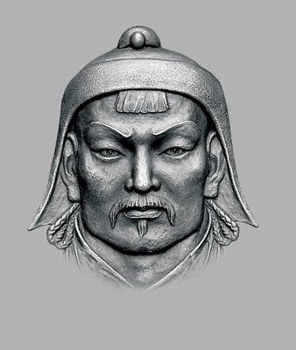
Who Was Their Leader?
Ghengis (Chinggis) Khan = Temujin
Born c. 1165
Had a “tough” upbringing in a nomadic society of tribal warfare
Became Mongol “khan” – leader
At a Great Assembly in 1206 he was made “Genghis Khan” – strong ruler
He unified the Mongols with a written language, big army and standardized laws
He started Mongol expansion south into China and west across Central Asia toward the Caspian Sea
Died in 1227

Slide 8
Yuan Dynasty in China
Led by Kubilai Khan, grandson of Ghengis
“Until about 20 years ago, most scholars of Mongol-era China emphasized the destructive influence of Mongol rule.”
(The Mongols in World History, http://afe.easia.columbia.edu/mongols/conquests/conquests_4.htm)
What happened to Chinese stability?
Could it hold up to the Mongols?
Did the Chinese lose their distinct cultural identity under foreign rule?
Did anything Chinese rub off on the Mongols?

Slide 9
Textbook Notes, 354-355
Who benefited from (or didn’t suffer as much) Mongol rule: why | Who suffered during Mongol rule: why
 | Unintended Consequences:
Unintended Consequences for Chinese innovations:

Slide 10
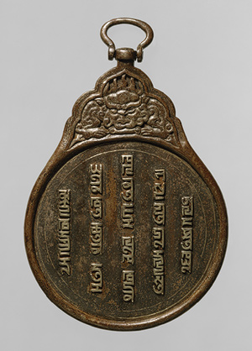
Primary Source Object = Physical Evidence
Passport = “symbol of Mongol administration used to regulate and secure communication in the vast empire”
Inscription in Mongol script:
By the strength of Eternal Heaven, an edict of the Emperor [Khan]. He who has no respect shall be guilty.
Mongol Passport, Metropolitan Museum of Art, Heilbrunn Timeline of Art History, 2000-2015 http://www.metmuseum.org/toah/images/h2/h2_1993.256.jpg (April 28, 2015)

Slide 11
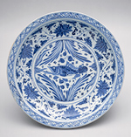
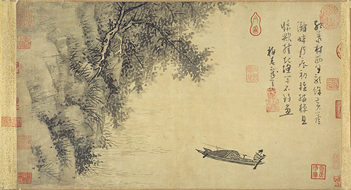
Yuan Dynasty
“Ironically, during this century of alien occupation, Chinese culture not only survived but was reinvigorated.”
Metropolitan Museum of Art, Heilbrunn Timeline of Art History: Yuan Dynasty, 2000-2015, http://www.metmuseum.org/toah/hd/yuan/hd_yuan.htm (Dec. 1, 2015)

Slide 12
Further Reading
http://www.metmuseum.org/toah/hd/khan1/hd_khan1.htm
http://afe.easia.columbia.edu/mongols/conquests/conquests_4.htm
The Mongols in World History
http://ngm.nationalgeographic.com/1996/12/genghis-khan/stanfield-photography
National Geographic, photo exhibit – see where Temujin was born

