Slide 1
Zuma’s Unforgettable Journey
By: Jamie Young, Nicole Tsinas, Iulia Iancu, and Andrew Patton

Slide 2
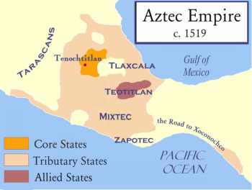
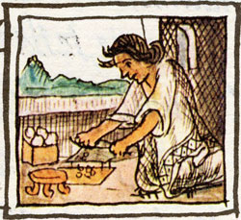
Welcome to the Family
By: Iulia Iancu
Gender Roles
There once was a boy named Zuma who was 18 years old. Zuma lives in the Aztec Empire close to the capital of Tenochtitlan. He had one sister, a mother and a father. On an ordinary day for this family Zuma’s mother would teach his sister how to cook, and make clothes and pottery. Meanwhile, the father had a more important role in protecting the family and providing for the family, and provide for the family as a farmer.
The Aztec Empire (1427-1521) is located in modern-day Mexico.

Slide 3
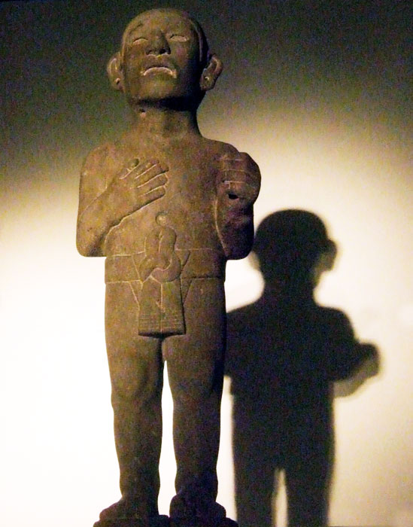
What is Zuma and his family
By: Andrew Patton
Social Structure
Zuma and his family are something known as commoners, they were the people who worked the lands and fished the seas. Some of them even specialized in certain crafts or even worked in the military. Most people in the Aztec world were commoners, they were a poorer people compared to the higher classes. Unlike the high classes of people, the commoners had laws that made them wear lower grade clothing as a sign of place in society. Zuma before he was selected for the festival would have worn this clothing but because he is part of the big festival he is given nice clothing and treatment almost like the higher classes.
A male commoner in regular male commoner clothing (a loincloth)

Slide 4
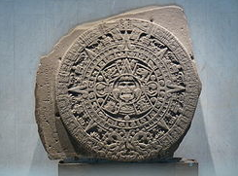
Zuma’s Purpose
By: Jamie Young
Belief Systems
Zuma was chosen from this fair family to be a part of the festival of Toxcatl. Taking part in this festival meant that Zuma would have to give away his heart to the gods that created him. This festival took place in the month of May around the Aztec calendar. It was an honor for Zuma to be a part of this party because the gods had given him so much. It was only right for Zuma to return their acts of kindness.
This is the Sun Stone that explained times of festivals on the Aztec calendar including Toxcatl.

Slide 5
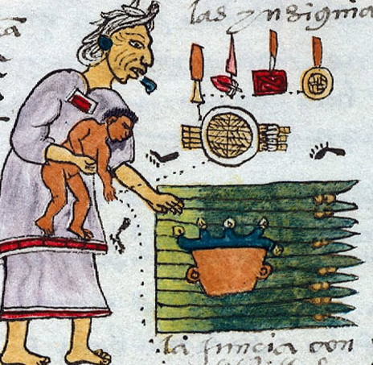
His Name
By: Jamie Young
Belief Systems
The name Zuma represented both “peace” and “health”. This name also meant “full of life”. Zuma was named through a naming ritual where he held an arrow in his hand and lay next to something that symbolized his dad’s job. In this case, Zuma lay next to a basket of fruit to symbolize that his father was a farmer. Because of Zuma’s name and family, he was the perfect fair young man to give up his heart to the gods.

Slide 6
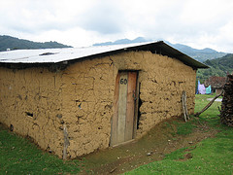
Zuma’s Home
By: Nicole Tsinas
Zuma knew going on this journey would mean he’d have to leave his house behind. Zuma adored his home. Everyone in his neighbourhood were humble people like him and his family. His house was built of bricks that were made out of mud mixed with straw, and wood. It may have not been the biggest house in Tenochtitlan but he loved it anyways.

Slide 7
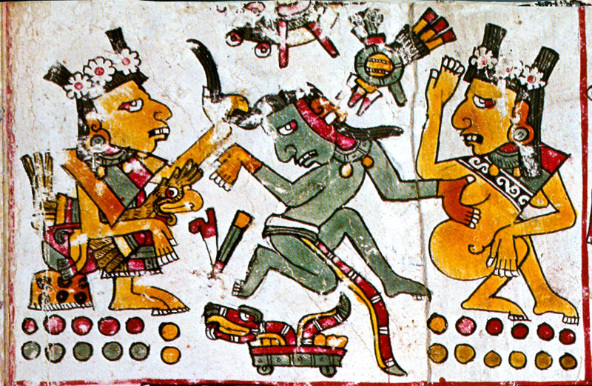
The Journey Begins…
By: Iulia Iancu
Gender Roles
Zuma and his family started their journey to the Great Temple, where the festival was taking place. Zuma was very excited to attend the festival. Yesterday, a priestess spoke to Zuma about the event, and told him exactly what would happen. She told Zuma it was a great honour to be sacrificed. Zuma believed her, because priestesses were very close to the Gods. It was a very important job to be a priest, especially for a woman.
A female priestess (right), surrounded by Gods.

Slide 8
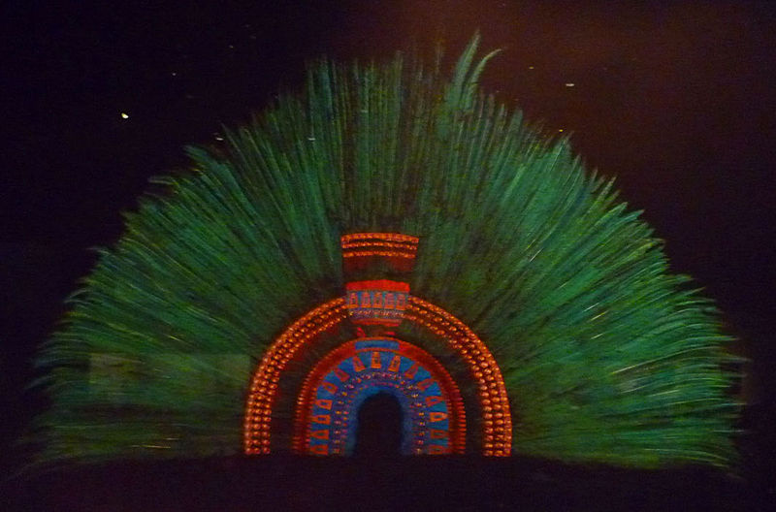
Zuma meets a Tlatloni
By: Andrew Patton
Social Structure
Zuma before the festival was given the great chance to meet his local Tlatoani. The Tlatoque were the rulers of this ancient civilization, they controlled the towns, cities, and communities under Aztec rule. They had great power as they controlled their owned lands, they managed labor and tributes, they acted as judges in higher court cases, controlled military power, and took part in some religious festivities. The Tlatoani like all other nobility wore lavish clothing and had piercings and fancy jewelry. Zuma was jealous that the nobility were able to wear fancy clothing like this all their lives and Zuma was only given these nice things once he was selected for the festival but Zuma knew that his part in the festivities was a greater and honorable thing.
A headdress that would have been worn by a ruler in the Aztec world

Slide 9
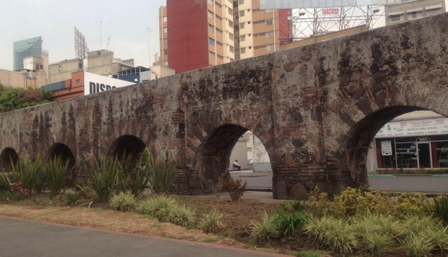
The Big Aqueduct
By: Nicole Tsinas
To continue along their journey, they had to pass a large aqueduct. Since Tenochtitlan was made on tiny marshy islands on Lake Tetzcoco, they had a small amount of drinking water. The aqueduct was built to carry freshwater over the lake from springs at a place called Chapultepec on the mainland. Zuma looked at the aqueduct in amazement, it was one of the most impressive things he’d ever seen!

Slide 10
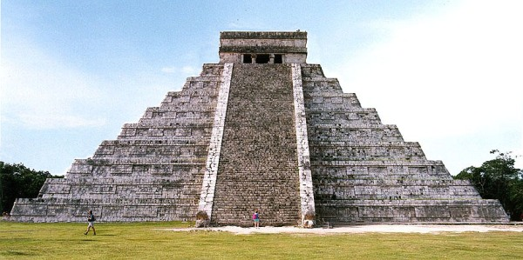
The Great Temple
By: Nicole Tsinas
After a long and incredible journey, Zuma and his dad finally did it – they made it to the Great Temple! The Great Temple was the main sacred religious building of the capitol city. It had two shrines on the top - one to Huitzilopochtli, the god of sun and war, and one to Tlaloc, the god of rain and fertility. Huitzilopochtli was the patron god of the Aztec people, the one who led them to Tenochtitlan in the first place. The Great Temple had a double staircase in the front and was very tall and steep. It was the most amazing Twin Stairs Pyramid in all of the Empire. Zuma was blown away!

Slide 11
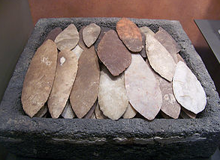
The End
By: Jamie Young
Belief Systems
As Zuma walked up the stairs of the Great Temple, he knew that giving his heart to the gods was the right thing to do. Zuma lay down on a big block of stone, and before the priest took out his heart with a special set of knives, this fair young man remembered the last year of his life; the times that he had lots of girlfriends and was treated with great amounts of honor and respect. Zuma knew that his last year had been everything a boy could have ever dreamed of, and even though Zuma knew he would miss his loving family and kind friends, he was looking forward to repaying the gods that gave him life.
These were the special knives that were used to take out Zuma’s heart before giving it to the gods.

