Slide 1
Moctezuma Xocoyotzin
1466-1520

Slide 2
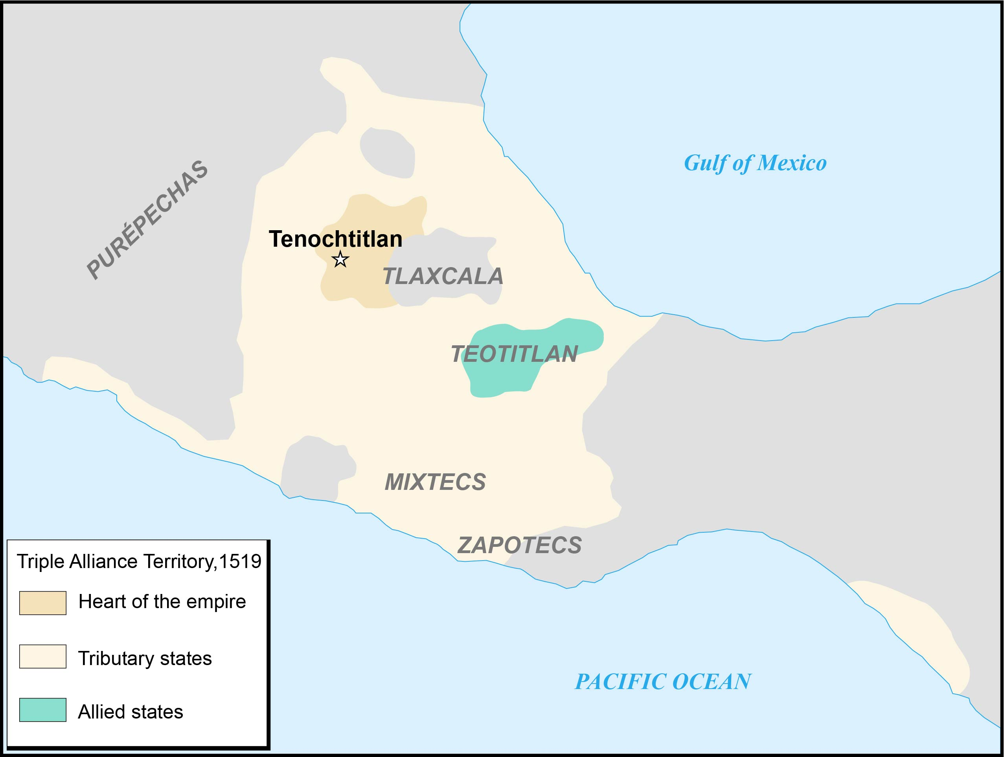
Notes:
Image adapted from https://commons.wikimedia.org/wiki/File:Aztec_Empire_1519_map-fr.svg#/media/File:Aztec_empire_1519-fr.svg

Slide 3
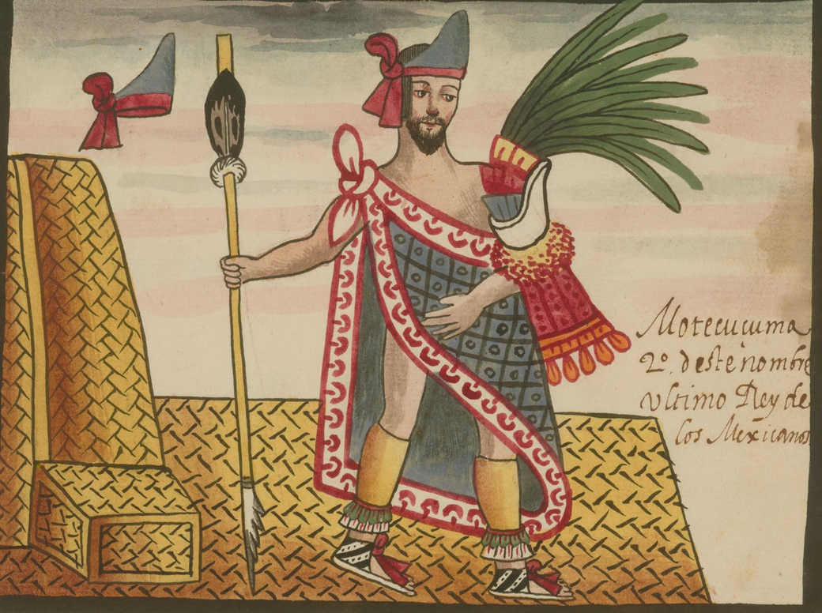
Moctezuma Xocoyotzin
Illustration of Moctezuma Xocoyotzin created around 1585
Notes:
Image retrieved from https://www.wdl.org/en/item/6724/

Slide 4
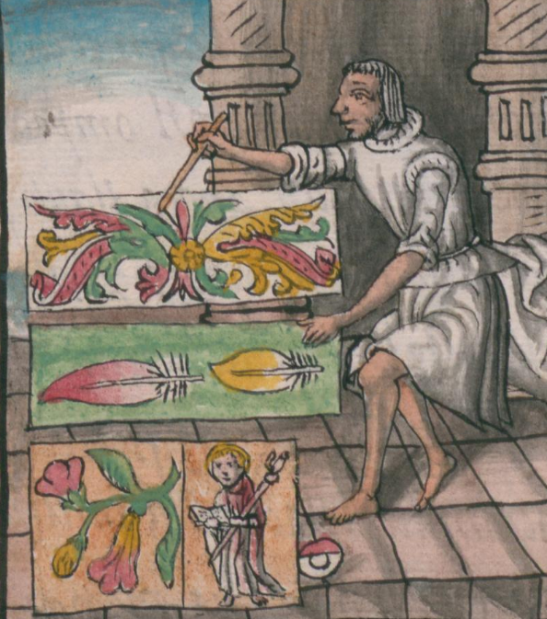
Tenochtitlan
Illustration of Mexica noblewoman, created around 1577
Illustration of Mexica feather artist at work, created around 1577
Notes:
Left image retrieved from the World Digital Library: https://www.wdl.org/en/item/10621/view/1/63/
Right image retrieved from the World Digital Library: https://www.wdl.org/en/item/10620/view/1/132/

Slide 5
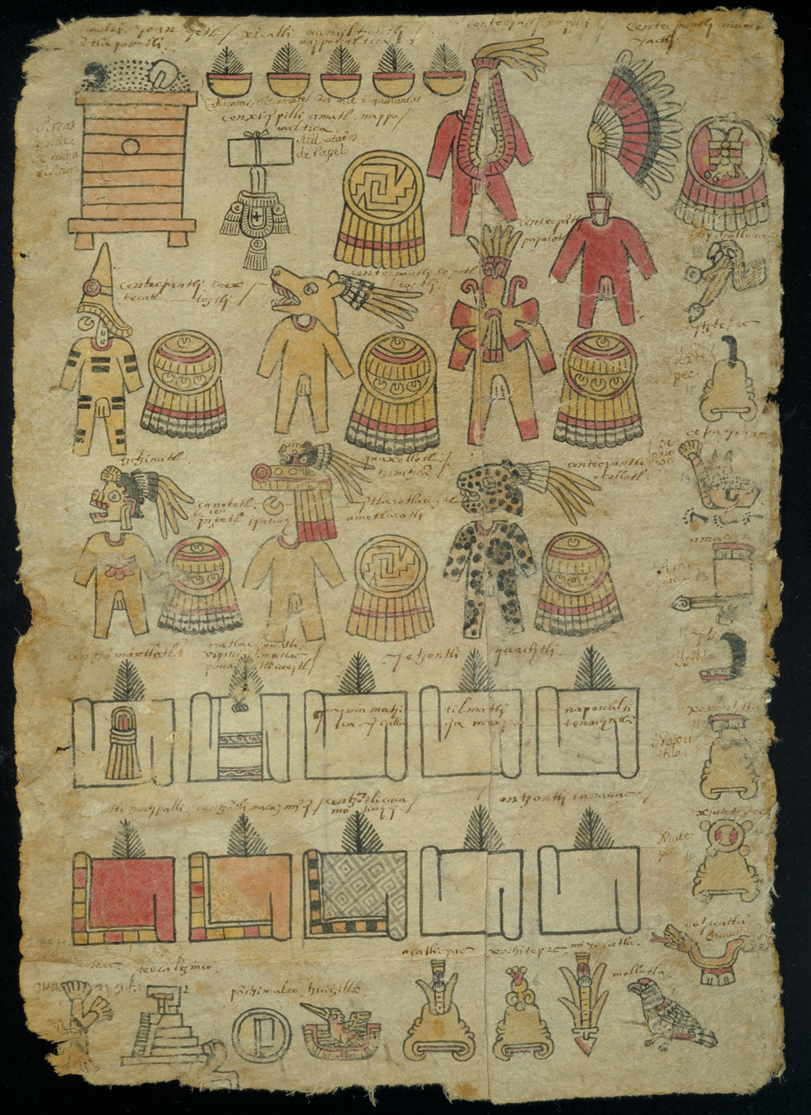
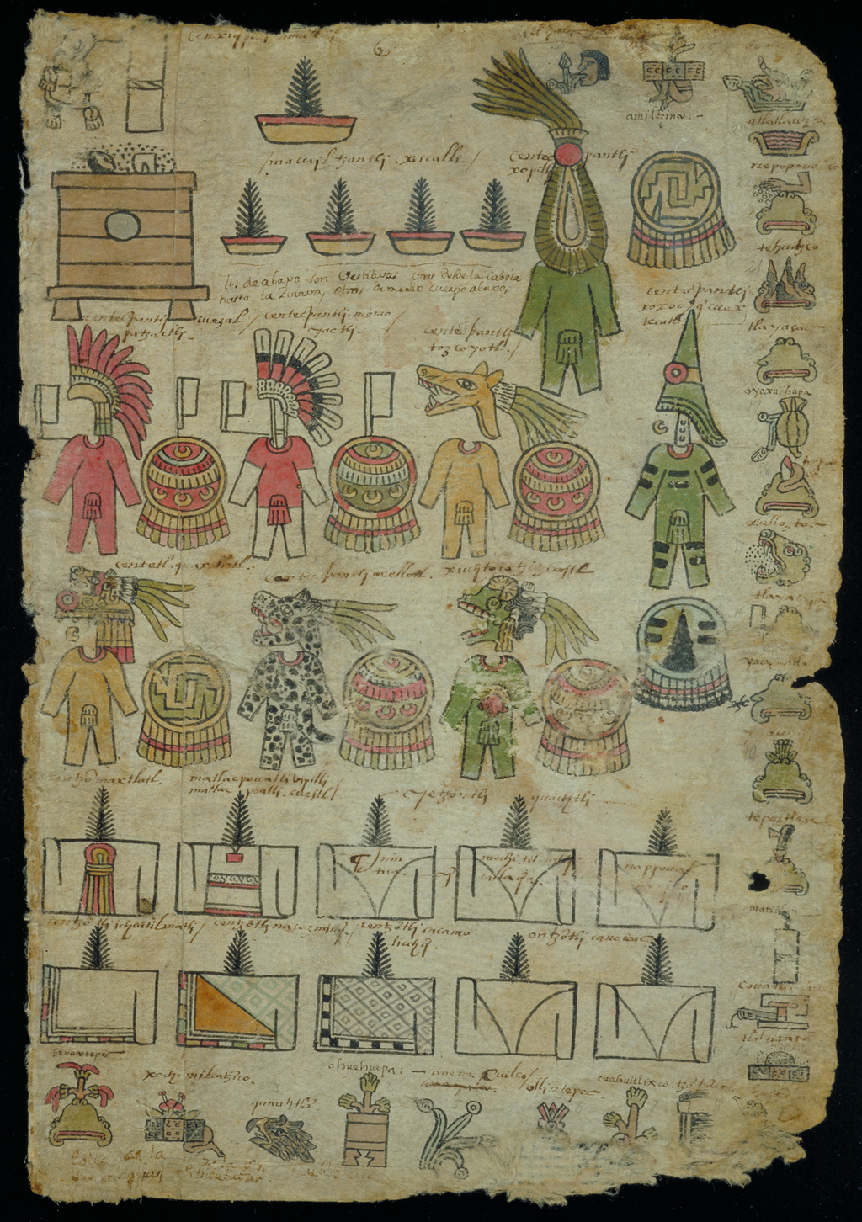
Tributes
Excerpts from Mexico-Tenochtitlan Tribute Roll, copied around 1522-1530 from a pre-conquest original
Notes:
Images retrieved from the World Digital Library: https://www.wdl.org/en/item/3248/view/1/5/

Slide 6
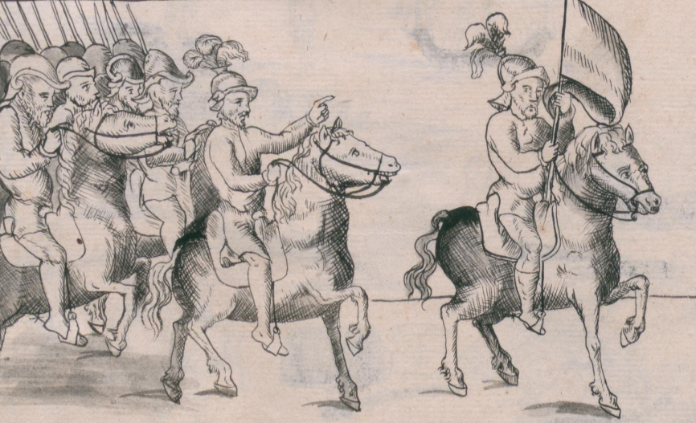
Spanish Colonization
Illustration of the Spanish marching into Mexico, created around 1577
Notes:
Image retrieved from the World Digital Library: https://www.wdl.org/en/item/10623/view/1/2/

Slide 7
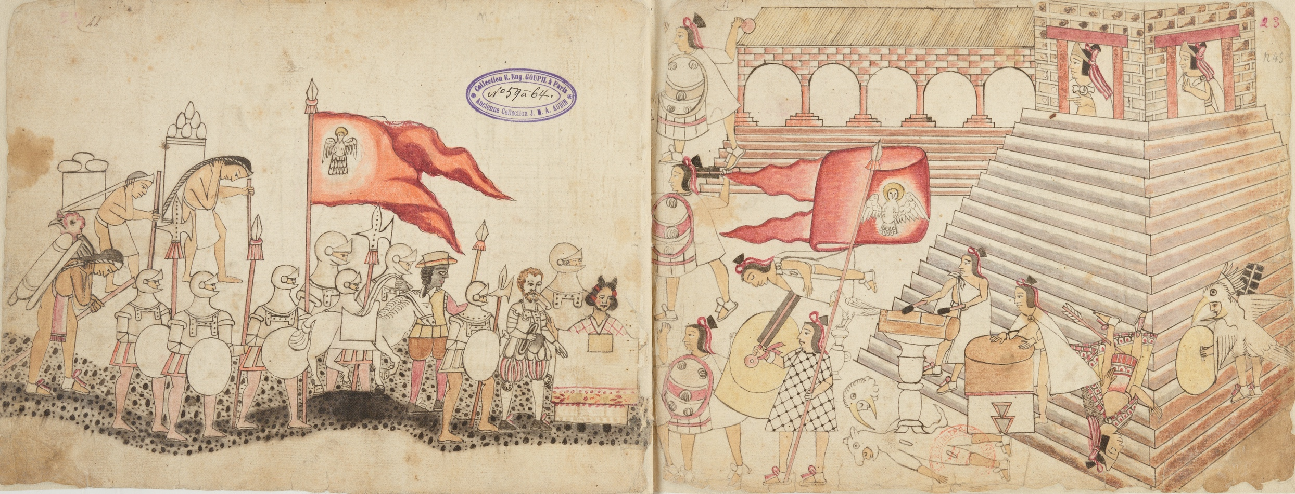
Conquest of Tenochtitlan
Illustration of the arrival of Spaniards and Malintzin in Tenochtitlan, created around 1530
Illustration of the massacre at the Main Temple and death of Moctezuma, created around 1530
Notes:
Image retrieved from the World Digital Library: https://www.wdl.org/en/item/15280/view/1/29/

Slide 8
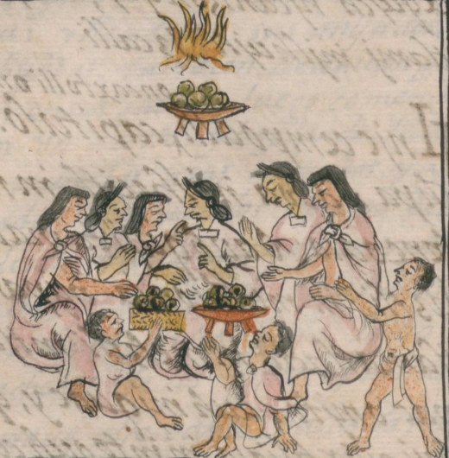
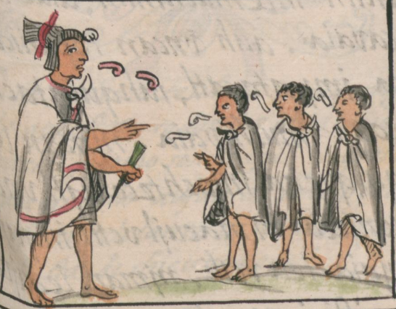
Tenochtitlan
Illustration of Mexica eating tamales during the feast of Tlaxochimaco, created around 1577
Illustration of Mexica priest with students, created around 1577
Notes:
Left image retrieved from the World Digital Library: https://www.wdl.org/en/item/10613/view/1/204/
Right image retrieved from the World Digital Library: https://www.wdl.org/en/item/10613/view/1/255/

