Slide 1
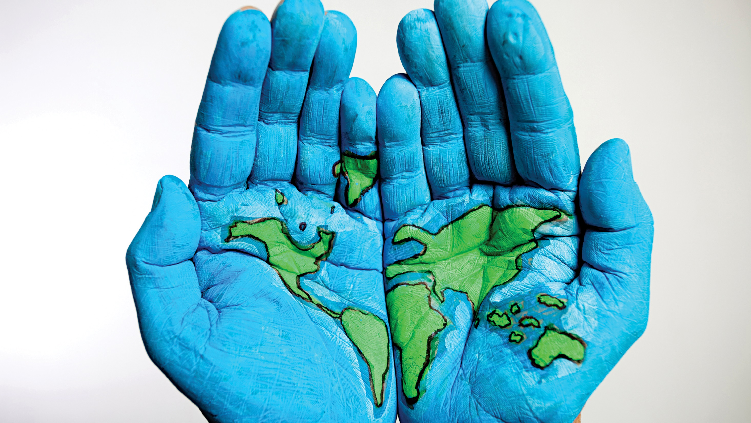
Conflict and Cooperation
CHY4U Unit 1
Activity 4

Slide 2
More to Trade
Trade and alliances did not just relate to economics and politics.
They also spread things like learning, culture, religion, and values.
Consider objects from history
Each object reveals something about its time and place.
Georgetown University, Law, International Trade Update, N.d., https://www.law.georgetown.edu/continuing-legal-education/programs/cle/international-trade-update/ (Feb. 12, 2017)

Slide 3
Making Inferences
Write three logical and sound inferences you can reach based on the objects in the next 3 slides.
Sample inference: "If a historian in the future found the link to this e learning course on your computer they could infer that you chose a history course because you enjoy studying history."
Write two inferences that may be true about the sources, but would require more evidence in order to validate (prove to be true).

Slide 4
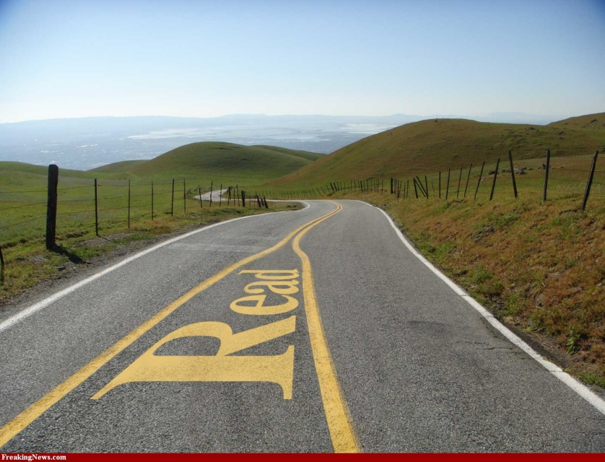
Inference
“conclusion based on reading between the lines of a source”
Peter Seixas and Tom Morton, The Big Six Historical Thinking
Concepts (Toronto: Nelson Education Ltd., 2013), glossary, 215.

Slide 5
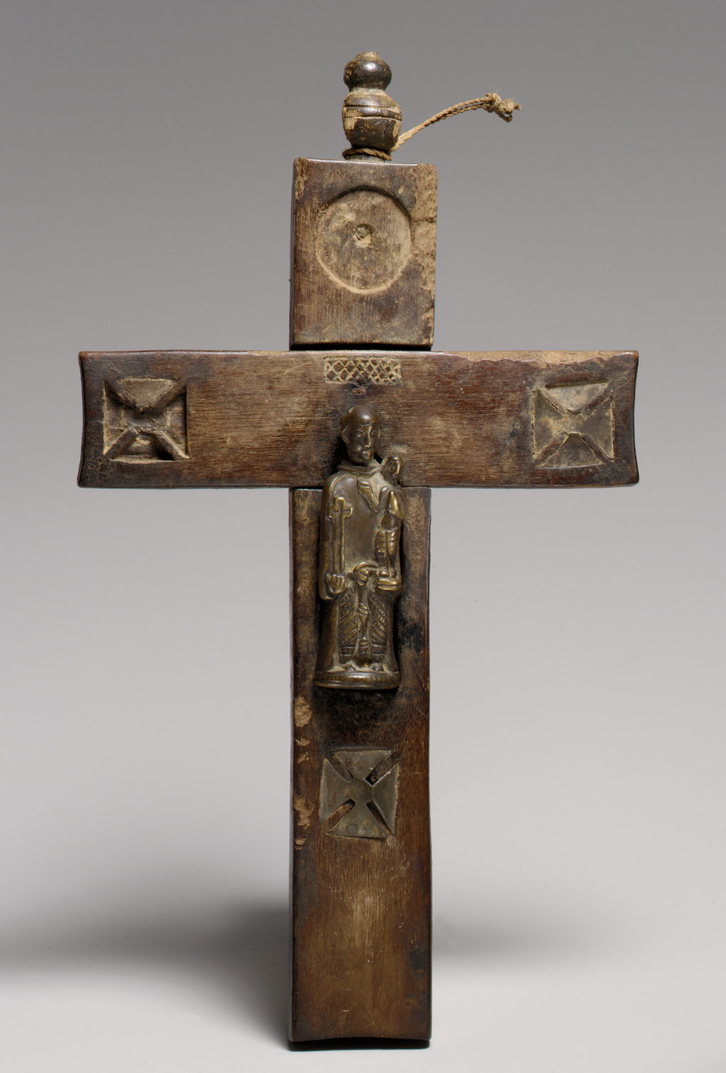
Object 1
The cross is from the Kongo. It is a mix of Kongolese and Christian traditions brought to the region by the Portuguese.
The Metropolitan Museum of Art, Heilbrunn Timeline of Art History, Cross: St. Antony of Padua, 2017, http://www.metmuseum.org/toah/works-of-art/1999.295.14/ (Feb. 12, 2017)

Slide 6
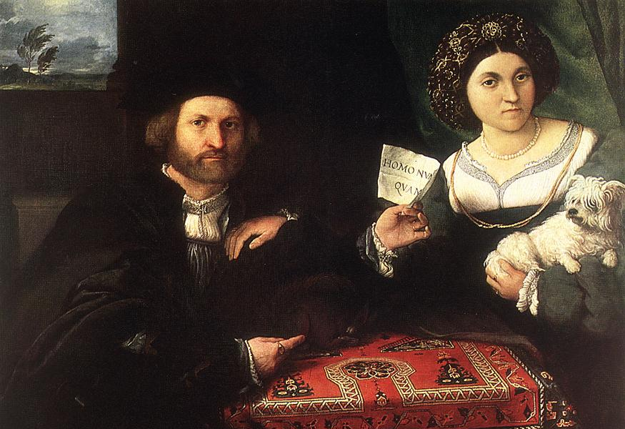
Object 2
The 1523 painting of the couple is by a Venetian artist. Their table is covered in a Persian rug, a popular luxury item among the wealthy in E.urope
Wikipedia, Oriental Carpets in Renaissance Paintings,Lorenzo Lotto: Husband and Wife, N.d., https://en.wikipedia.org/wiki/Oriental_carpets_in_Renaissance_painting#/media/File:Lotto,_Lorenzo_-_Husband_and_Wife.jpg (Feb. 12, 2017).

Slide 7
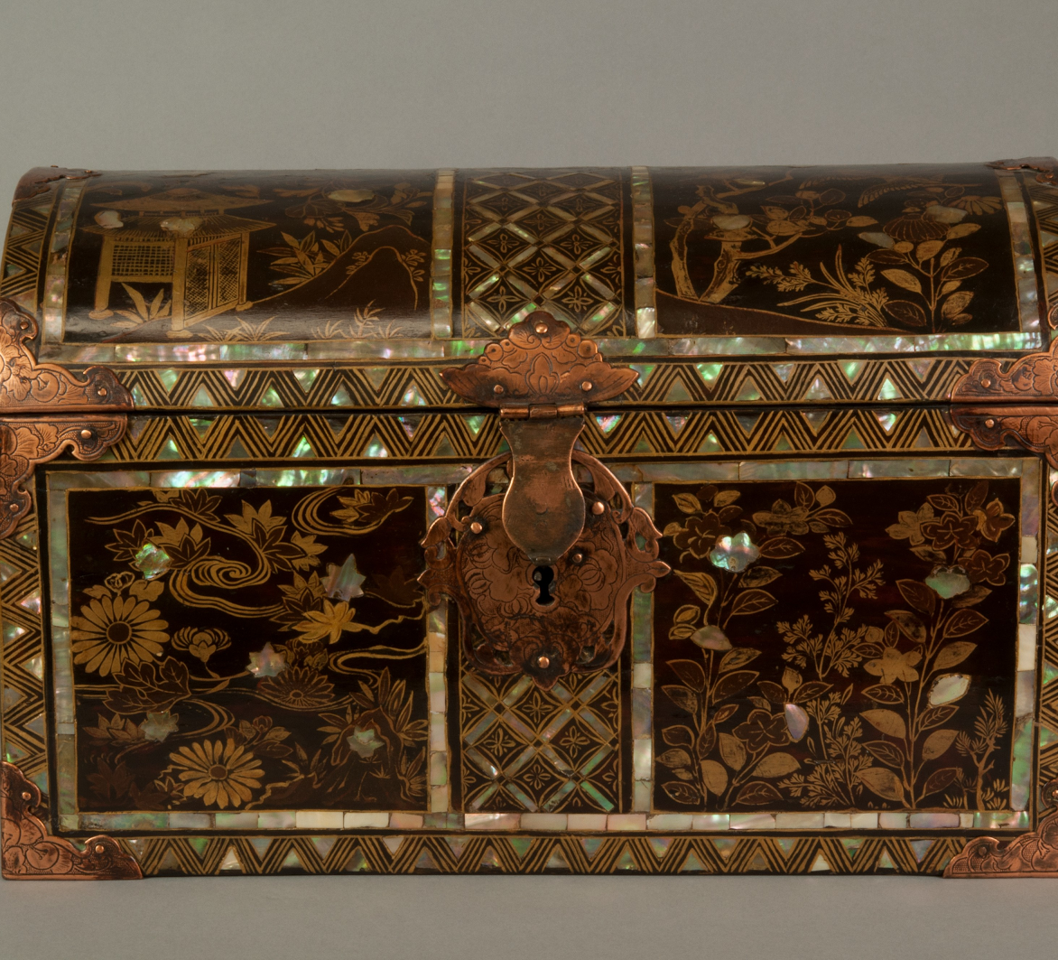
Object 3
The coffer was made in Japan (1600-1630). The ornamentation features Indian influences. The box itself reflects European designs; it was specifically built for Portuguese and European markets. The style of build was called Nanban, which translates to “Southern Barbarians.”
The Metropolitan Museum of Art, Coffer in Nanban, 2017, http://www.metmuseum.org/art/collection/search/40342 (Feb. 12, 2017).

Slide 8
Context
“the circumstances at the time of the creation of a source; the society and belief system in which the source was created as well as the historical events taking place at the time”
P E R S I A T acronym helps you remember the various parts of a society
(p = political; e = economic, r = religious, s = social, I = intellectual, a = artistic, t = technological)
Ibid.

Slide 9
Trade Routes

Slide 10
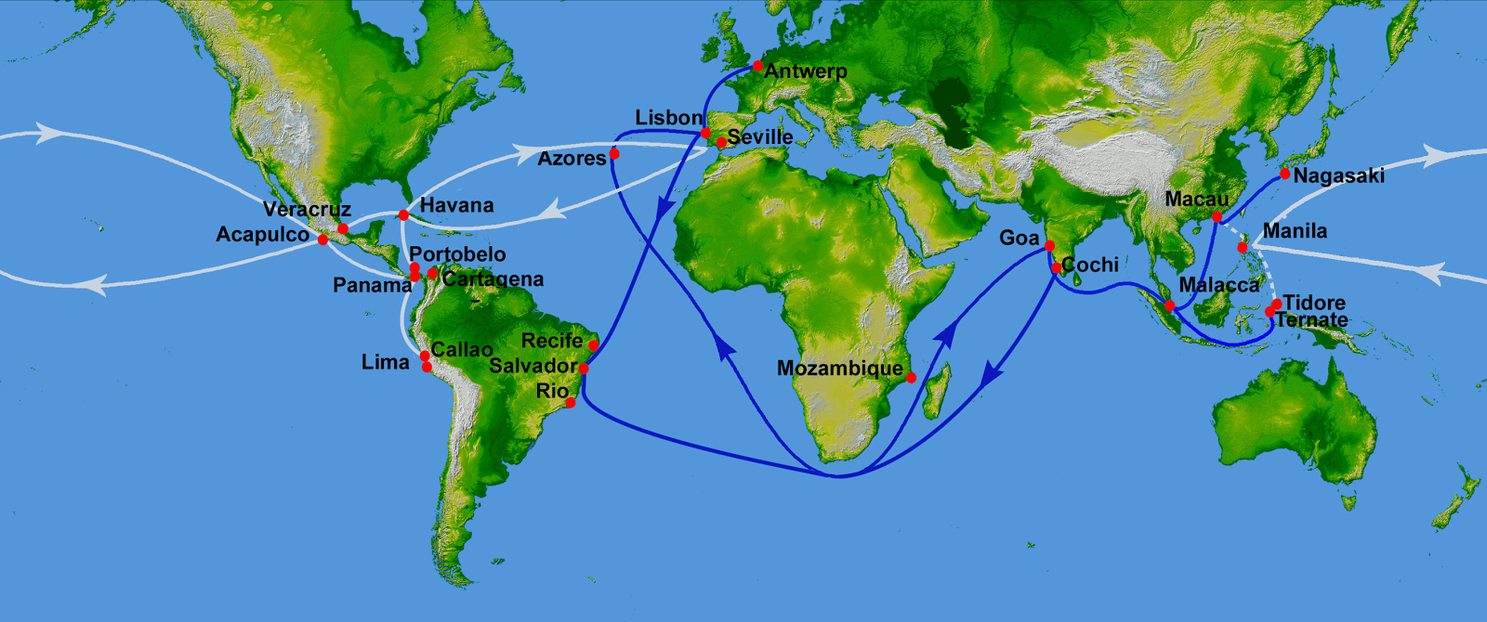
Spanish (white) and Portuguese (blue) trade routes
Figure 1https://abagond.files.wordpress.com/2010/05/african-slave-trade-11.jpg

Slide 11
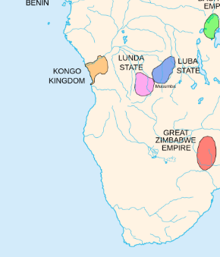

Slide 12
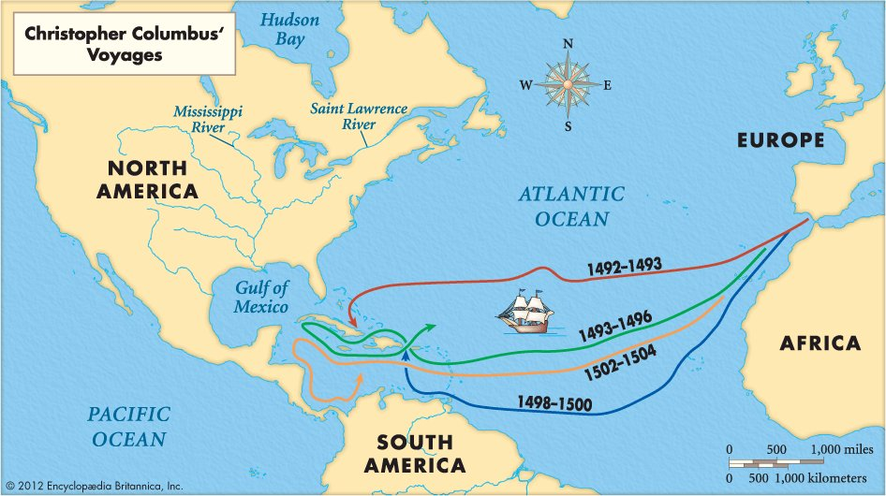
http://kids.britannica.com/elementary/art-88703/The-four-voyages-of-Christopher-Columbus

