Slide 1
Women’s Rights in Britain
Unit 3, Activity 5 – Reform Movements
CHY 4U

Slide 2
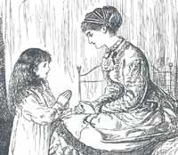
19th Century Women
Domestic - moral
Hidden under petticoats
Lynn Abrams, BBC History, Ideals of Womanhood in Victorian Britain, 2001, http://www.bbc.co.uk/history/lj/victorian_britainlj/idealwomen_03.shtml?site=history_society_welfare (Nov. 23, 2005).

Slide 3
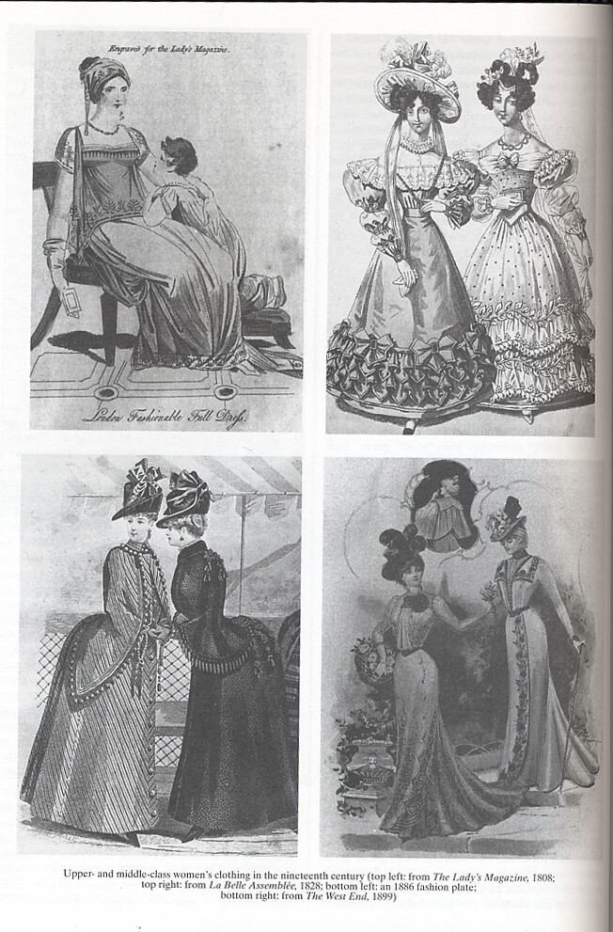
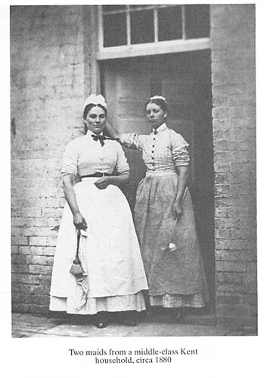
Clothing
Middle Class ←
Working class →
James Farr, World Eras, Vol. 9: Industrial Revolution in Europe (Detroit: Gale, 2003), 226, 139.

Slide 4
Middle Class Ideal: Separate Spheres
Private Sphere | Public Sphere
Home | Outside the home
Leisure time | Working time
Family | Non-family relations
Personal relationships | Impersonal relationships
Legitimate love and sexuality | Illegitimate sexuality
morality | Immorality
harmony | Division
Ibid., p. 268.

Slide 5
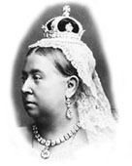
Victorian Britain
Queen Victoria
BBC History, Historic Figures, Queen Victoria, N.d., http://www.bbc.co.uk/history/historic_figures/victoria_queen.shtml (Nov. 23, 2005).

Slide 6
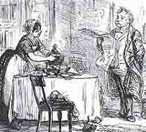
Double Burden for Working Class
Work and looking after the home and family
Lynn Abrams, BBC History, Ideals of Womanhood in Victorian Britain, 2001, http://www.bbc.co.uk/history/lj/victorian_britainlj/idealwomen_03.shtml?site=history_society_welfare (Nov. 23, 2005).

Slide 7
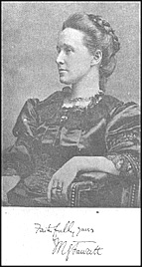
Suffragists - Moderates
Millicent Fawcett, NUWSS leader
NUWSS Banner
Helena Wojtczak, Victorian Web, The National Union of Women’s Suffrage Societies, 2000, http://www.victorianweb.org/gender/wojtczak/nuwss.html (Nov. 23, 2005).

Slide 8
Middle Class Values
Public speaking, efforts to persuade parliament
BBC, GCSE Bitesize, History: Votes for Women, 2010,
http://www.bbc.co.uk/schools/gcsebitesize/history/mwh/britain/votesforwomenrev1.shtml (Dec. 12, 2010).

Slide 9
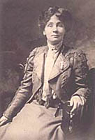
Suffragettes - Militants
Women’s Social and Political Union banner
Emmeline Pankhurst, WSPU leader, 1908
Helena Wojtczak, The Women’s Social and Political Union, Victorian Web, 2000, http://www.victorianweb.org/gender/wojtczak/wspu.html (Nov. 23, 2005).
BBC History, Historic Figure,. Emmeline Pankhurst, N.d., http://www.bbc.co.uk/history/historic_figures/pankhurst_emmeline.shtml (Nov. 23, 2005).

Slide 10
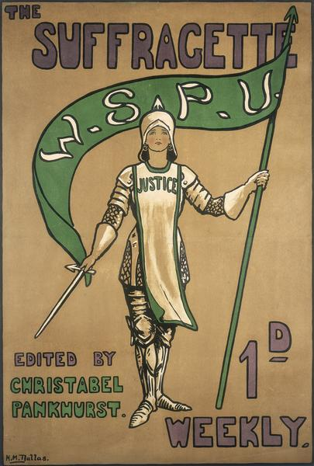
Suffragette Methods
Pamphlets and press
Museum of London Picture Library, N.d., http://www.museumoflondon.org.uk/frames.shtml?http://www.museumoflondon.org.uk/MOLsite/piclib/pages/bigpicture.asp?id=1044 (Nov. 26, 2005); Dominic Casciani, Spy Pictures of Suffragettes Revealed, BBC News, 2003, http://news.bbc.co.uk/1/hi/magazine/3153024.stm (Nov. 23, 2005).

Slide 11
Meetings
1908 Suffragette meeting
Another Nickel in the Machine, 2009, http://www.nickelinthemachine.com/tag/suffragettes/ (Dec.
12, 2010).

Slide 12
Books and Fundraising
1911 “An Anti-Suffrage Alphabet” makes fun of those who oppose women’s suffrage; made to raise money
Museum of London, An Anti-Suffrage Alphabet: 1911, Image Number 003576, N.d.,
http://www.museumoflondonprints.com/image.php?id=195363&idx=0&fromsea
rch=true (Dec. 12, 2010).

Slide 13
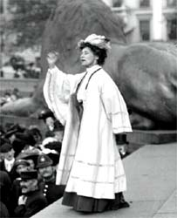
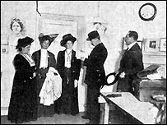
Demonstrations and Arrests
Arrests of suffragettes
Emmeline Pankhurst speaking in Trafalgar Square
Casciani, The History of the Suffragettes.

Slide 14
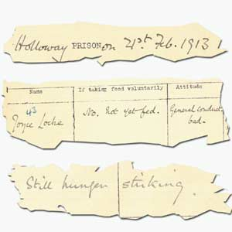
Hunger Strikes
Prison notes on hunger strikes
Gaining sympathy
Casciani, Spy Pictures of Suffragettes Revealed, BBC News, 2003, http://news.bbc.co.uk/1/hi/magazine/3153024.stm (Nov. 23, 2005); John Bull and Uncle Sam, 4 Centuries of British American Relations, Library of Congress, 2000, http://www.loc.gov/exhibits/british/brit-4.html (Nov. 23, 2005).

Slide 15
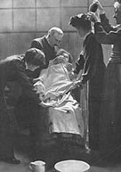
Gov’t Response
Lady Constance Georgina Lytton - injured by force feeding
Being force fed
BBC History, Historic Figure, Emily Davison, N.d., http://www.bbc.co.uk/history/historic_figures/davison_emily.shtml (Nov. 26, 2005); BBC History, Historic Figures, Lady Constance Georgina Lytton, N.d., http://www.bbc.co.uk/history/historic_figures/lytton_constance_georgina.shtml
(Nov. 26, 2005).

Slide 16
Violence
Catapult used to break windows in 1911 WSPU campaign – 200 women arrested
Museum of London, Catapult Used for Breaking Windows: 20th Century, Image 003301, N.d.,
http://www.museumoflondonprints.com/image.php?id=134440&idx=2&fromsearch=true (Dec. 12, 2010).

Slide 17
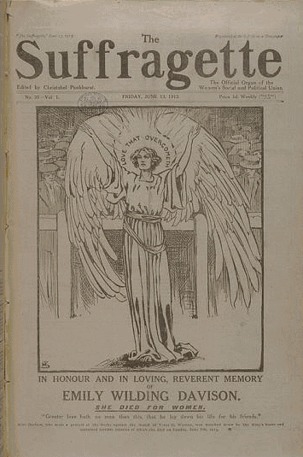
The Most Radical Method?
Emily Davison, martyr
June, 1913 in memory of Davison
Microfilm Services at British Library Newspapers, 1997, http://www.bl.uk/collections/micro.html (Nov. 26, 2005).

Slide 18
Martyrdom
Davison on Derby Day 1913 in front of the king’s horse
H Marcuse, UCSB History, 2003, http://www.history.ucsb.edu/faculty/marcuse/classes/2c/2c03L14.htm(Nov. 26, 2005).

Slide 19
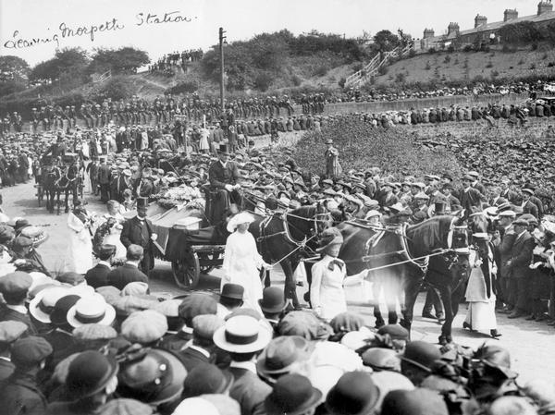
Sympathy
Emily Davison’s Funeral
Museum of London Picture Library, N.d., http://www.museumoflondon.org.uk/frames.shtml?http://www.museumoflondon.org.uk/MOLsite/piclib/pages/bigpicture.asp?id=1044 (Nov. 26, 2005).

Slide 20
Cheered...
Released from prison
The National Archives Learning Curve, Power Politics and Protest, N.d., http://www.learningcurve.gov.uk/politics/g9/source/g9s2a.htm (Nov. 26, 2005).

Slide 21
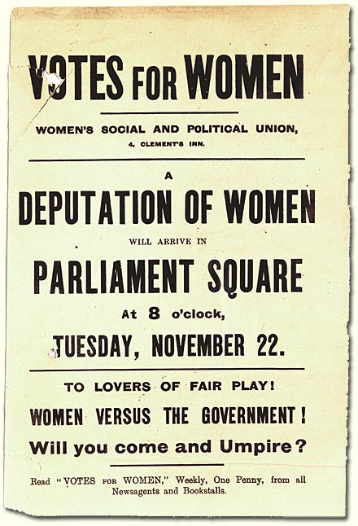
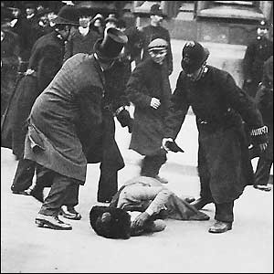
...and Reviled
Invitation to parliamentary demonstration 1910
Ernestine Mills at the demonstration
The National Archives Learning Curve, Power, Politics and Protests, N.d., http://www.learningcurve.gov.uk/politics/g9/source/g9s2bhtm (Nov. 26, 2005).

Slide 22
Anti-Suffragette Messages
National Campaign for Opposing Woman Suffrage
Learn History, Crime, Punishment and Protest Through Time, c. 1450-2004, The Suffrage Movement,
2004, http://www.learnhistory.org.uk/cpp/suffagettes.htm (Dec. 12, 2010).

Slide 23
Postcard
1909 postcard sent to WSPU head-quarters
Museum of London, Home Sweet Home: Striking Example of a Suffragette’s Home: 1909, Image 002829, N.d.,
http://www.museumoflondonprints.com/image.php?id=129256&idx=2&fromsearch=true (Dec. 12, 2010).

Slide 24
Anti-Women’s Suffrage Postcards, 1910
Museum of London, Two Anti-Women’s Suffrage Postcards: 1910, Image 003554, N.d.,
http://www.museumoflondonprints.com/image.php?id=177688&idx=1&fromsearch=true (Dec. 12, 2010).

Slide 25
Postcard
1912 anti-suffrage postcard
Museum of London, No Votes, Thank You. The Appeal of Womanhood Postcard: 1912, Image 001686, N.d.,
http://www.museumoflondonprints.com/image.php?id=211412&idx=3&fromsearch=true# (Dec. 12, 2010).

Slide 26
Postcard
1909 anti-suffrage postcard
Museum of London, Mummy’s a Suffragette: 1909, Image 000252, N.d.,
http://www.museumoflondonprints.com/image.php?id=322926&idx=3&fromsearch=true (Dec. 12, 2010).

Slide 27
The Vote
1918 law giving women over 30 the right to vote, and postcard – “At Last”
Museum of London, The Reform Act of 1918 and Postcard “At Last!”, Image 003581, N.d.,
http://www.museumoflondonprints.com/image.php?id=177779&idx=3&fromserch=true (Dec. 12, 2010).

