Slide 1
Forced Migration
CHY4U Unit 4
Activity 3

Slide 2
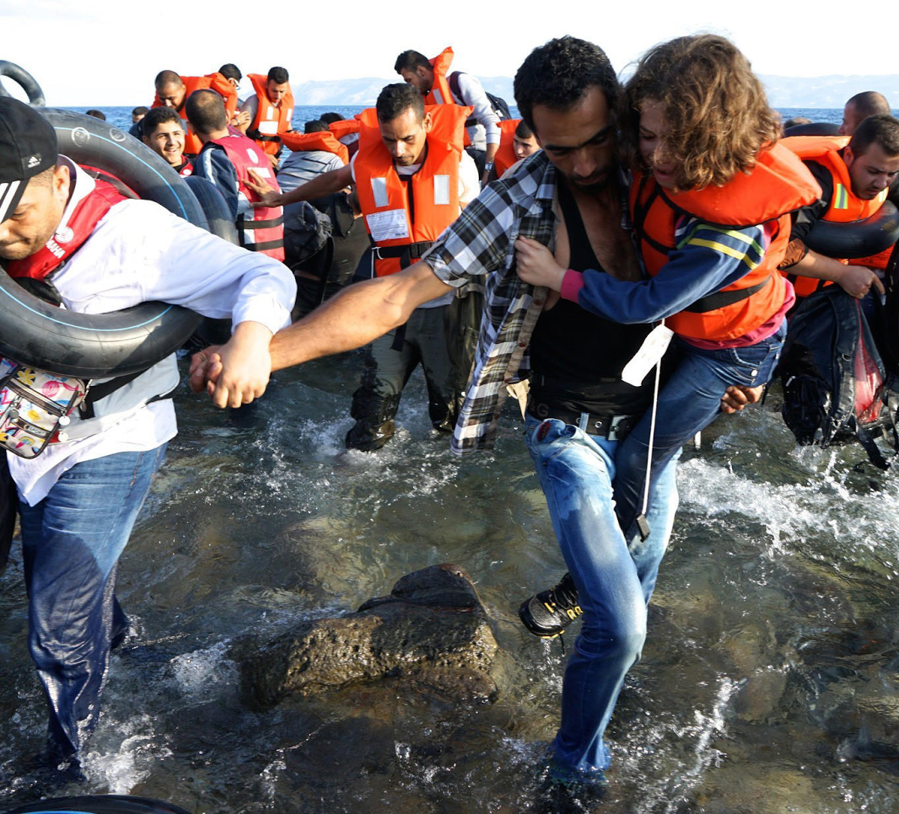
This 2015 photo, taken by Liliana Nieto del Rio, shows Syrians desperately trying to reach the shores of Greece. Notice the lifejackets and inner tubes used by the refugees to keep them safe during their journey.
http://graphics.latimes.com/syria-to-greece/

Slide 3
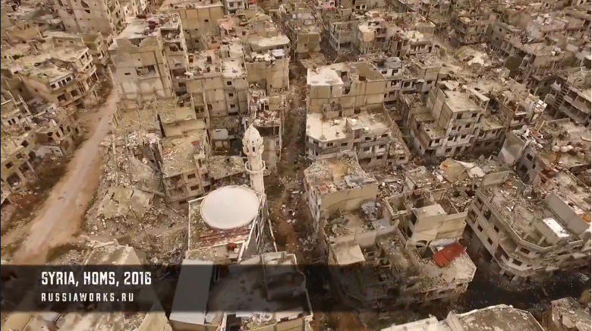
This still image is from a drone video that was taken flying over the city of Homs, Syria in February 2016, by a Russian journalism team, Russia Works.
http://www.businessinsider.com/russiaworks-drone-footage-damage-syria-homs-2016-2

Slide 4
Migrants struggle to board a train at the railway station in Budapest, Hungary in 2015. (AP Photo/Frank Augstein)
Washington Examiner http://www.washingtonexaminer.com/article/2571374

Slide 5
Video #1
This video from the UK’s Guardian explains the historical roots of the crisis.
https://www.youtube.com/watch?v=K5H5w3_QTG0

Slide 6
Video #2
This video from a Munich based YouTube channel analyses the international response to the crisis. (6:16)
https://www.youtube.com/watch?v=RvOnXh3NN9w

Slide 7
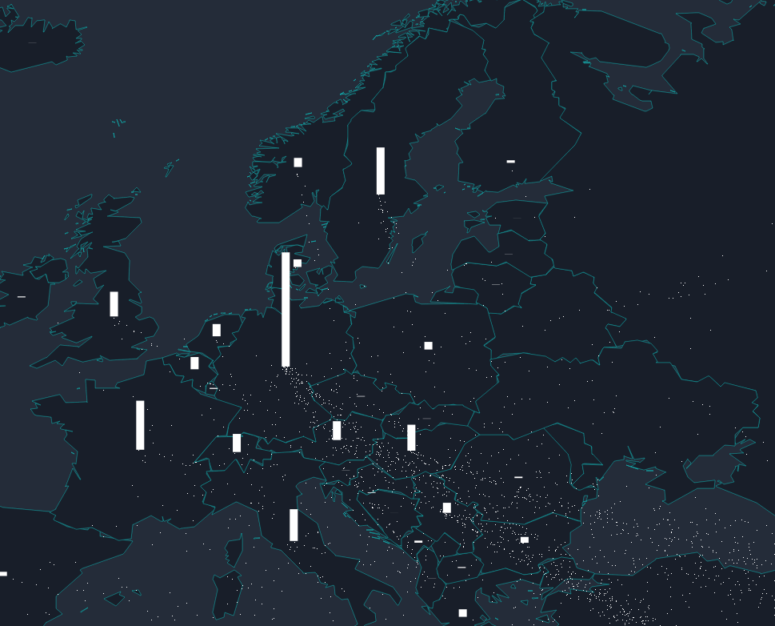
Animated Brexit Map
http://www.lucify.com/the-flow-towards-europe/
For the photos and posters that follow, identify which were in favour and which were against Britain’s exit from the EU.

Slide 8
A photo from the Brexit campaign:
http://i1.mirror.co.uk/incoming/article8282543.ece/ALTERNATES/s615b/PAY-Pro-European-campaigners.jpg

Slide 9
A photo from the Brexit campaign:
http://fm.cnbc.com/applications/cnbc.com/resources/img/editorial/2016/06/17/103724330-GettyImages-540326878.530x298.jpg?v=1466172749

Slide 10
A poster from the Brexit campaign:
https://i.guim.co.uk/img/media/02b230449f750df147b3f85fa7ce060bae0b325a/494_0_3002_1801/master/3002.jpg?w=620&q=55&auto=format&usm=12&fit=max&s=57cd6e1ead459a2a4cef81ac8d41c101

Slide 11
A poster from the Brexit campaign:
https://www.youtube.com/watch?v=n6SUexTvuWU

