Slide 1
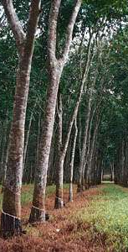
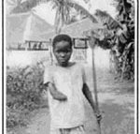
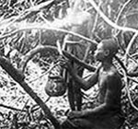
Congo Imperialism
Case Study
CHY4U Unit 3
May 2020
Yale University, Genocide Studies Program, Congo Free State, 2010,accessed Nov. 22, 2013, http://www.yale.edu/gsp/colonial/belgian_congo/ .

Slide 2
Civilization?
What are your thoughts on this word?

Slide 3
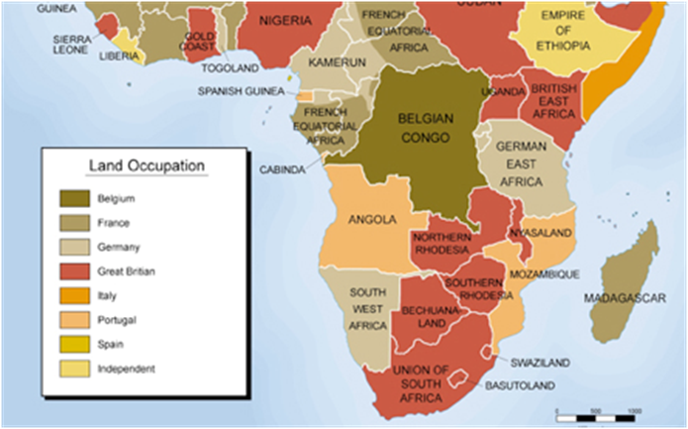

“Belgian” Congo
Michigan State University, Exploring Africa, Central Africa, accessed May 2 2016, http://exploringafrica.matrix.msu.edu/curriculum/unit-four/module-eighteen/module-eighteen-activity-two/.

Slide 4
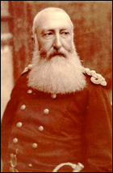
How Congo Became a Belgian Colony
“From 1886 (the conclusion of the Berlin Conference) to 1908, the Congo Free State (as the colony was known) was ruled as the private domain of King Leopold II of Belgium. Using the guidelines for colonization established by the Berlin Conference, Leopold employed personal aides and representatives who used deceit, thuggery, and violence to gain control of the Congo as his own personal fiefdom. … Leopold…put in place a barbaric system similar to that of the plantation in the Americas, where human beings were degraded, brutalized and denied any human rights.
To finance this enterprise, the King leased nation-size lands to private companies. These companies had the license to make a profit, but in return had to pay taxes and tribute to the king. …These companies forced local inhabitants to collect wild rubber without compensation for their labor. Able-bodied men were given a quota of rubber that they were expected to collect and turn into the companies. Failure meet the quota had dire consequences—one of the hands of the ‘defaulter’ was cut off ….”
King Leopold II of Belgium
Michigan State University, Exploring Africa, Central Africa, accessed May 2, 2016, http://exploringafrica.matrix.msu.edu/curriculum/unit-four/module-eighteen/module-eighteen-activity-two/.

Slide 5
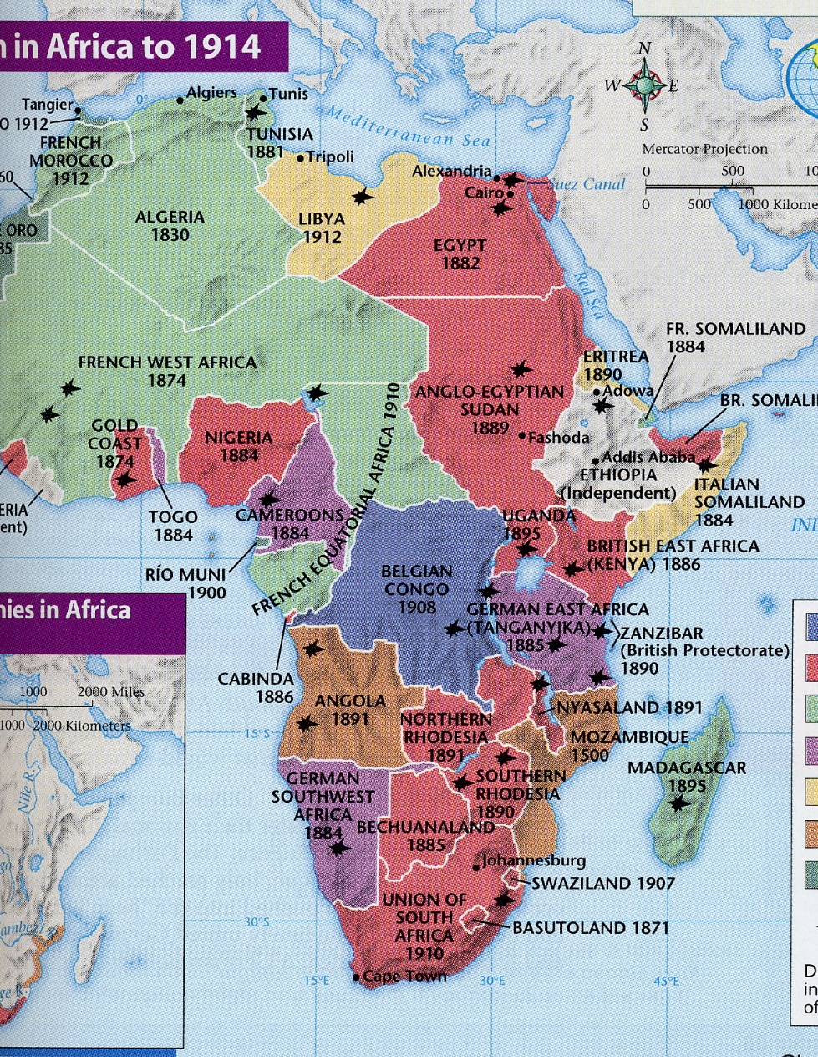
Competitive Imperialism
“Carve up” Africa / “Scramble for” Africa
At first Germany didn’t want to have colonies
  Then with change of Emperor (Kaiser) they got in on the competition
1885 Berlin Conference
  European powers defined “occupation”
  Tried to deal with competing “claims”
  Who was not part of this decision-making?

Slide 6
Berlin Conference
“Imperial tensions grew to the point where it was thought useful to call an international conference to deal with the partition and development of Africa. Attended by the United States and the European nations, the conference was held in Berlin in 1885. It was agreed that a country occupying a coastline had the right to the interior. Occupation was to be ‘effective,’ not simply on paper; a country claiming an area could not simply plant the flag and expect recognition of its sovereignty. Each state was required to notify the others of areas it claimed.”
Haberman and Shubert, The West and the World (Toronto: Gage, 2002), p. 304.

Slide 7
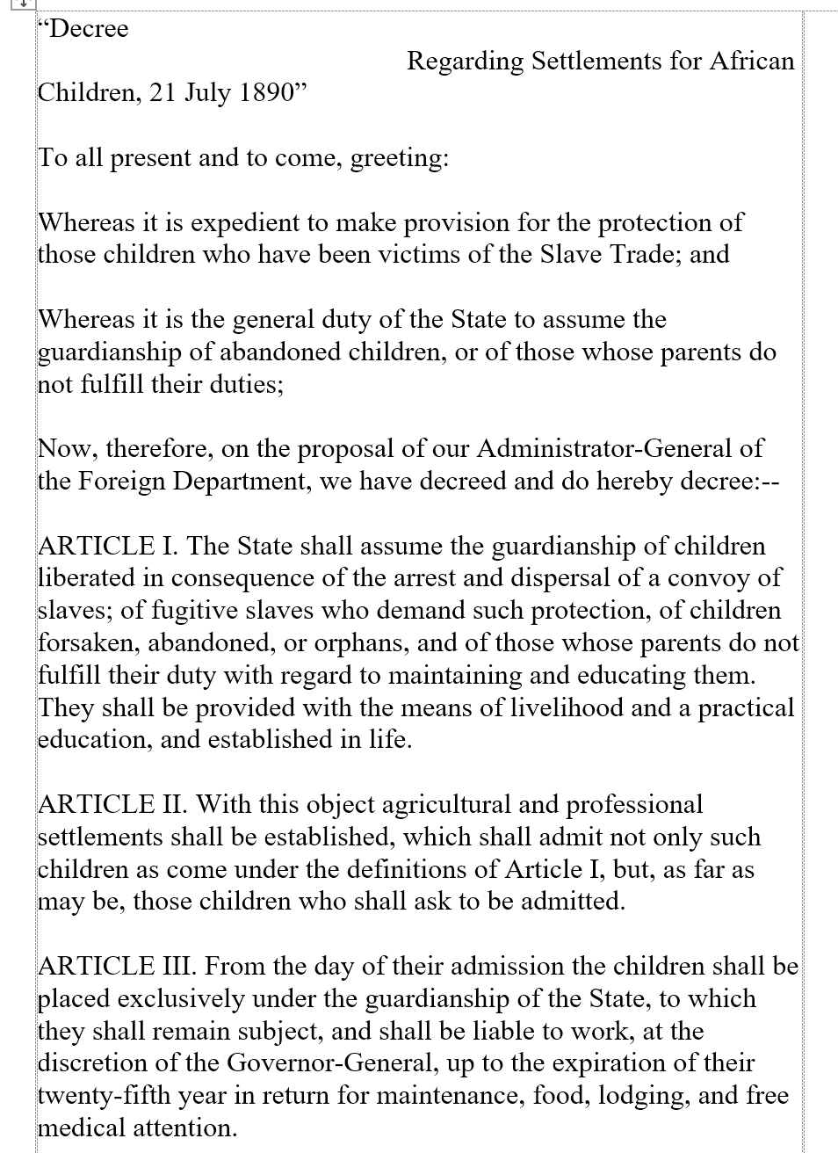



PSD Interpretation – Focusing on Audience
Who do you think wrote this decree? Under which circumstances?
How might the intended audience have shaped the decree?
How might the audience have responded to the decree?
Do you have any reasons to doubt the seeming benevolence (kindness) of this decree?
George Mason University, World History Sources, Be the historian, Official Documents: Who was the primary audience for the document, N.d., http://chnm.gmu.edu/worldhistorysources/unpacking/docsq4ex.php?s=one (April 29, 2013).

Slide 8
PSD
The document is actually called:
  Decree of Leopold II, King of the Belgians, Sovereign of the Independent State of the Congo
    That was hidden from you to help you focus in one who this decree might have been aimed at
      In the past a lot of students have felt that it was written by the international community aimed at protecting children in Congo.
      Some students have also correctly interpreted that it was written by Leopold and that it is full of obfuscating language.

Slide 9
Some Context on the PSD Decree
2. " ... children who have been victims of the Slave Trade;"
King Leopold II also claimed to protect victims of the slave trade. In reality, however, his method of “protection” was actually enslavement. Colonial soldiers also arranged to have children, along with their mothers, kidnapped and placed in stockades, an experience of terror and confinement familiar to many African slaves. The Congo hostages would be released if men in their family gathered enough rubber to fulfill a stiff company quota. If these workers feared for their own lives and fled, their shackled offspring could become the “children forsaken” in “agricultural and professional settlements.”
Ibid.; http://chnm.gmu.edu/worldhistorysources/unpacking/bentranscript.html

Slide 10
3. " ... children liberated in consequence of the arrest and dispersal of a convoy of slaves;"
King Leopold II does not indicate who was “liberating” the children in a dispersed “convoy of slaves.” In fact, he created orphans with the intention of pressing them into unpaid labor.
…
5. ARTICLE III
ARTICLE III is explicit about how to protect young children “liable to work” for more than two decades “at the discretion of the Governor-General.” King Leopold II constantly feared labor shortages, which could disrupt rubber collection. Shortages resulted from a number of factors, but mainly Force Publique rampages and attendant African flight. Thus, “agricultural and professional settlements,” as the decree states, became pools of accessible workers, for the children living there were required to toil in return for “maintenance.” They engaged in rubber procurement, running a gauntlet of retribution and torture for perceived indolence; or hauled loads up to half their body weight to and from boats along the Congo River.
Ibid.

Slide 11
PSD – More Practice
Below are two letters written by Leopold to Belgian agents in the Congo. The first letter was public, and available to all. The second letter, however, was intended only for those working for Leopold.
After reading the letters, do the following:
Explain how Leopold saw the role of religion.
Explain why the content and tone of these two letters is so different.
What can you conclude about the consequences of Leopold’s policies in the Congo?
How do the different primary source documents corroborate each other?
Definition: corroborate - to confirm or give support to a statement, theory or finding.

Slide 12
Letter 1
The following is an excerpt from a public letter written by King Leopold to all Belgian agents working in the Congo.
“The task which the Belgian agents have to accomplish in the Congo is noble. It is incumbent upon them [necessary] to carry on the work of civilization in Africa. The aim [goal] is to regenerate [re-make] races whose degradation and misfortune is hard to realize. The fearful scourges in the eyes of our humanity, these races are the victim. This is already lessening, little by little, through our intervention. Each step forward by our people should mark an improvement in the condition of the natives. In those vast (huge) regions of land, mostly uncultivated (unused) and mainly unproductive, where the natives hardly knew how to get their own daily food, European experience, knowledge, resources, and enterprise (skills) have brought to light unimaginable wealth. Exploration of virgin (new) lands goes on, communications are established, highways are opened, and legitimate trade and industry are established.
Source: Letter from King Leopold II of Belgium to all government agents in the Congo, June 16, 1897.

Slide 13
Letter 2
The following is an excerpt from a private letter written by King Leopold to a group of Belgian missionaries about to leave for the Congo in 1883.
“Reverends, Fathers and Dear Compatriots: The task that is given to you is very difficult. You will go certainly to evangelize, but your priority must be Belgium interests. Your principal mission in the Congo is never to teach the savages to know God, this they know already. They speak and submit to a Mungu, one Nzambi, one Nzakomba, and what else I don’t know (all of these are native African gods).Your essential role is to facilitate the task of administrators and industrialists, which means you will go to interpret the gospel in the way it will be the best to protect our interests in that part of the world. Your knowledge of the gospel will allow you to find texts encouraging your followers to love poverty, like “Happier are the poor because they will inherit the heaven" and, "It’s very difficult for the rich to enter the kingdom of God." You have to make them abandon everything which gives them the courage to affront[resist] us. Evangelize the savages so that they stay forever in submission to the white colonialists, so they never revolt against the restraints they are undergoing. Recite every day-"Happy are those who are weeping because the kingdom of God is for them." Convert the blacks always by using the whip.
Source: Letter from King Leopold II of Belgium to Colonial Missionaries, 1883. Illuminate Education. Reading: King Leopold Primary Source Documents. 2016. https://app.activateinstruction.org/playlist/resource-sview/id/51d3386607121c63391309e2/rid/51d420cd07121c582e828d4b/bc0/explore/bc1/playlist (Jan. 27, 2017)

Slide 14
What Happened to Leopold II?
In the end, his Congo Free State colony was taken out of his private hands and made a colony belonging to the Belgian state. You can read in the unit 3 handouts how the Casement Report contributed to this end.
  Not much of a penalty compared to the millions who died in this genocide.

Slide 15
Philosophical Justifications for Imperialism
Social Darwinism

Slide 16
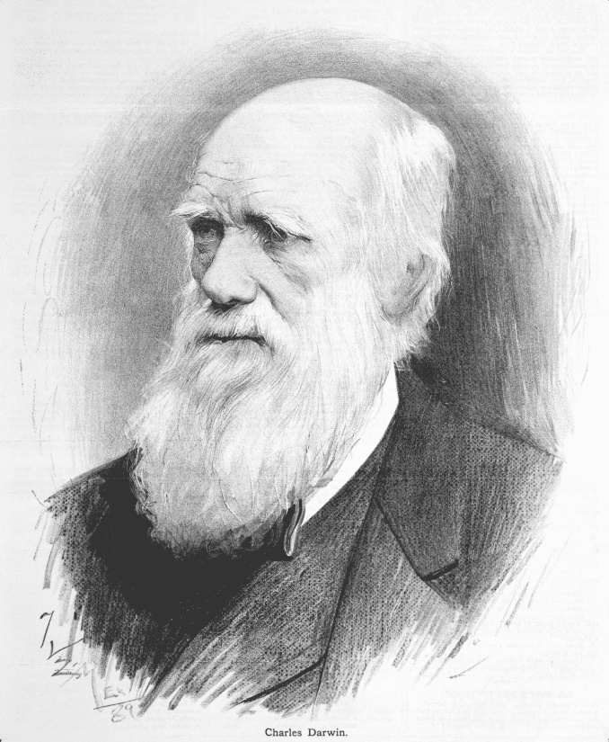
Darwin
Late 1850s onward:
  Charles Darwin’s theory of evolution by means of natural selection became prominent
    Whichever species best adapted to the environment survived
    “Survival of the fittest”

Slide 17
Social Darwinism
Darwin’s theory was misapplied by some people to human groups and races.
Some groups of people were deemed better adapted, biologically, for survival. This was used to justify imperialism.
White, Christian, employed,
wealthy – capitalist, industrialized, technological, educated
Therefore, who would be seen by the imperialists as being on the bottom?
non-white, non-Christian, unemployed, poor, non-technological, agricultural – non-industrialized, uneducated

Slide 18
See Outline Example in Unit 3 Handouts
Pages 42 and 43
  Ms. G has taken information about Congo and turned it into a sample of an essay outline following the point/example/argument + HTC connection format

Slide 19
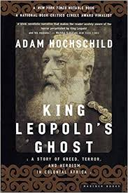
Concluding Thoughts on Congo?
A very meaningful book in my life as a history teacher. I had never learned about this genocide in high school or in university.
What about you?

