Slide 1
Islam and Science
CHW3M Spring 2018

Slide 2
What do the following objects and places tell you about Islamic people of the Middle Ages?

Slide 3
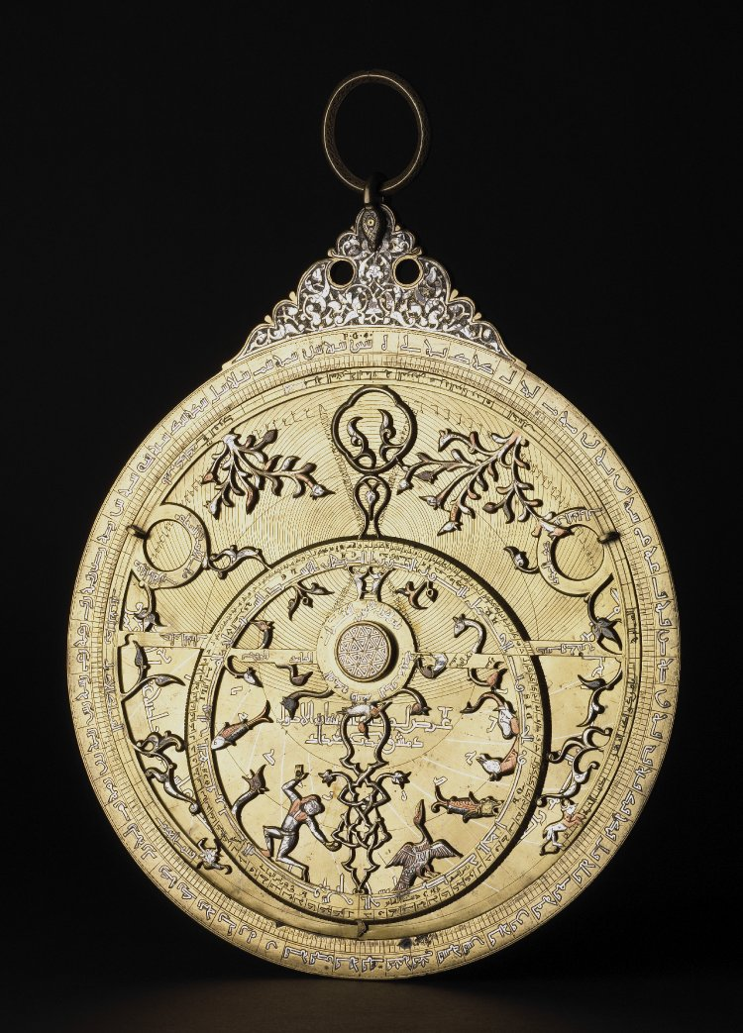
Astrolabe
http://www.britishmuseum.org/research/collection_online/collection_object_details/collection_image_gallery.aspx?assetId=8074001&objectId=239436&partId=1
“This could be used to measure the height and position of the stars to tell the time.” See how in this 9 minute video. Or read more about astrolabes here.

Slide 4
Medieval Cairo
Founded by the Shia Fatimid dynasty, Cairo had a library containing hundreds of thousands of manuscripts and was home to one of the world’s oldest universities, Al Azhar, attached to the Al Azhar mosque.
It was a city of tolerance.
https://www.agakhanmuseum.org/exhibitions/world-fatimids?utm_source=print&utm_medium=print&utm_campaign=The%20World%20of%20the%20Fatimids (scroll down to watch short video)

Slide 5
The House of Wisdom
Baghdad in the 9th century was the wealthy new capital city of the Abbasid dynasty
1
Scholars came to share information and study
2
Translations were made of Greek originals (e.g., Aristotle)
3
The House of Wisdom was a research academy
4
http://www.1001inventions.com/house-of-wisdom
5
Watch this short video

Slide 6
Islam and Science
“Early Islamic teaching encouraged and promoted the pursuit of scholarship and science. Seeking knowledge about the natural world was seen as the duty of every Muslim as the following Hadith (sayings of the Prophet Muhammad) show:
‘He who pursues the road of knowledge, Allah will direct to the road of Paradise…’ (From Science in Medieval Islam by H. Turner)
‘The scholar’s ink is holier that the martyr’s blood…’”
Museum of the History of Science, Science and Technology in Medieval Islam , N.d., http://www.mhs.ox.ac.uk/scienceislam_education/docs/Science_and_technology_in_Medieval_Islam-Teachers_notes.pdf (Nov. 15, 2015)

