Slide 1
Taoism and confucianism
CHW3M China unit
Nov. 2019
Confucianism part based on transcription of Bettany Hughes - Genius of the Ancient World – Confucius episode: https://www.youtube.com/watch?v=TII9ucKT70o

Slide 2
Ancient china pre-500s BCE
Advanced and innovative monarchy established by Shang dynasty
Western Zhou dynasty: a number of regional states eventually came info conflict but they did have a unified culture
Included the view of the emperor as the ‘son of heaven’ having the ‘mandate of heaven’
Eastern Zhou dynasty: includes Warring States period
Confucius lived during this dynasty and looked back at the Western Zhou as a golden age
http://afe.easia.columbia.edu/main_pop/kpct/kp_zhou.htm

Slide 3
Yin yang
Dualistic, complimentary, interconnected forces in the universe
Human and nature
Yin: feminine, dark, passive, soft, earth
Yang: male, light, active, hard, heaven

Slide 4
Taoism
“nonaction or noninterference with the natural order of things” (https://www.metmuseum.org/toah/hd/daoi/hd_daoi.htm)
The way = path to achieving a state of enlightenment resulting in longevity or even immortality (Ibid.)
The way – humans shouldn’t influence it
society took us away from the spontaneous way
need harmony through nature (Ibid.)

Slide 5
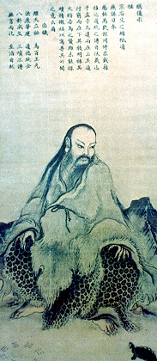
Taoism
“Humans model themselves on earth, Earth on heaven, Heaven on the Way, And the way on that which is naturally so.”
Taoism incorporated the idea of Yin Yang into the philosophy of being one with nature, with the idea that one should follow the way, the tao.

Slide 6
Do nothing and nothing will not be done.
- wuwei

Slide 8
Kong fuzi’s background
Stability declined at his time (550 BCE): cycle of war, invasions, lords rebelling, independent states all fought each other.
Chinese worldview saw order and harmony as essential goals for life on earth’s continuity.
Rituals were not directed toward a creator god or supreme power.
There were 2 cosmic forces (natural) – the dragon is the heavenly force, the phoenix is the female earthly force – locked in tension.
Humans’ role is to keep the balance through ritual.

Slide 9
Systematic philosophical inquiry
Kong Fuzi saw the gap between the idea and the reality of his time.
Chinese leaders at his time were devoted to the pursuit of personal gain.
He came upon some early Taoists emphasizing nature as the way but rejected their approach.
He sought a practical/political angle – the way was not a cosmic force, but the harmony resulting from an ordered society that could be achieved through human action.
Model from the past: Duke of Zhou

Slide 10
Virtue through rituals
Reverence, respect, internal goodness.
Through rituals
Not mechanically

Slide 11
family
He found inspiration in the family where there were hierarchical relationships with fixed responsibilities and learned relationships from birth.
People recognize their place and fulfill mutual relationships.
Families are driven by loyalty, honesty, duty, respect and love for those around them.
Love
Obedience

Slide 12
Ren and learning
Ren: human-heartedness, good or goodness, humanity.
Courage with ren. Justice with ren. Human justice not harsh punishment. Wisdom with ren is being wise, not just smart.
Every person can be in touch with ren, but to realize it fully requires learning. Learning to do one’s character is the highest ideal and minimum requirement to be human.
Had Kong Fuzi felt he achieved ren? No, continuous struggle to the end of his (and everyone’s) life to be fully human.

Slide 13
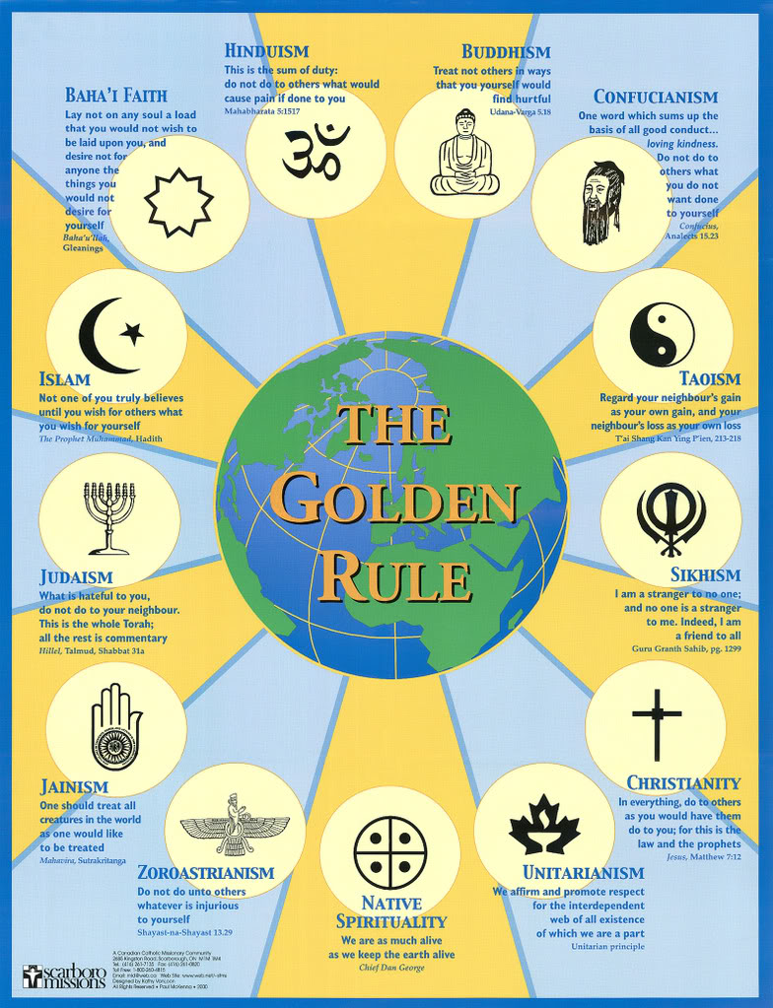
Golden rule
Don’t do to others what you do not wish for yourself.
Ren means compassion. We don’t operate in isolation. Our relationships are key.
Empathy.
This Photo by Unknown Author is licensed under CC BY-NC-ND

Slide 14
This Photo by Unknown Author is licensed under CC BY-SA

Slide 15
task
Identify which quotes are Taoist, which are Confucianist.

